Slide 1
Changes to Joint Multi-Agency Safeguarding Adults Policy and Procedures (West Yorkshire, North Yorkshire and City of York)
Nicola Webb
(Safeguarding Policy and Development Officer, Health and Adult Services)
& Haydn Rees Jones
(Safeguarding Policy Implementation Officer, Health and Adult Services)

Slide 2
Housekeeping
Emergency Procedure
Facilities
Breaks
Communications Equipment
Questions
Copies of presentation

Slide 3
Aims
Give you an outline of the changes to the new multi-agency procedures
Changes to the online pathways for the Front Door and through the Customer Service Centre
Give you access to resources which can be used to update staff regarding the changes to procedures
Preparation for implementation 1st October

Slide 4
What we will discuss before break
The Care Act
Policies and Procedures
Making Safeguarding Personal
Stage 1 – Reporting a Safeguarding Concern
New North Yorkshire Safeguarding Adults Procedures
Key changes

Slide 5
Safeguarding and the Care Act 2014
Safeguarding means protecting an adult’s right to live in safety, free from abuse and neglect.
‘It is about people and organisations working together to prevent and stop both the risks and experience of abuse or neglect, while at the same time making sure that the adult’s wellbeing is promoted including, where appropriate, having regard to their views, wishes, feelings and beliefs in deciding on any action.
This must recognise that adults sometimes have complex interpersonal relationships and may be ambivalent, unclear or unrealistic about their personal circumstances.’
Notes:
Reference: Care and Support Statutory Guidance

Slide 6
The Care Act (2014) Local Authorities duties and responsibilities
Local Authorities must:
make enquiries, or cause others to do so, if it believes an adult is experiencing, or is at risk of, abuse or neglect. …. An enquiry should establish whether any action needs to be taken to prevent or stop abuse or neglect, and if so, by whom
co-operate with each of its relevant partners …. in order to protect the adult

Slide 7
Section 42 criteria
The 3-Stage test for a Statutory S42 Enquiry:-
  Has needs for care and support (whether or not the authority is meeting any of those needs),
  Is experiencing, or is at risk of, abuse or neglect, and
  As a result of those needs is unable to protect himself or herself against the abuse or neglect or the risk of it.

Slide 8
Non Statutory Safeguarding Enquiries
Local authorities are not required by law to carry out safeguarding enquiries on behalf of adults who do not fit the criteria outlined in Section 42 of the Care Act 2014; they do so at their own discretion. These enquiries would relate to an adult who:
Is believed to be experiencing, or is at risk of, abuse or neglect; and
Does not have care and support needs (but might have just support needs).
Within the scope of this definition are:
Adults who manage their own care and support through personal or health budgets;
Adults whose needs for care and support have not been assessed as eligible or which have been assessed as below the level of eligibility for support;
Adults who fund their own care and support;
Young people
Carers

Slide 9
Care Act 2014
Local Authorities must also co-operate with such other agencies or bodies as it considers appropriate in the exercise of its adult safeguarding functions, including:
General Practitioners
Dentists
Pharmacists
NHS hospitals, and
Housing, health and care providers
Safeguarding is a statutory requirement and all organisation must follow the policies and procedures provided by the Board

Slide 10
Review of agreed Multi-Agency Policy and Procedures
Seven Safeguarding Adults Boards worked together to review the Multi-Agency Safeguarding Adults Policy and Procedure, this included:
  Bradford,
  Calderdale,
  Kirklees,
  Leeds,
  York,
  Wakefield and
  North Yorkshire
Notes:
Each Local Authority has its own operational guidance

Slide 11
Review of Safeguarding Policy and Procedures
The current version of the Policy and Procedures was launched when the Care Act was implemented
New statutory guidance in 2016 highlighted the need for Making Safeguarding Personal and changes to responding to self-neglect
There was also the need to strengthen the Community Safety Partnership Agenda, including Prevent, Modern Slavery and Domestic Abuse
There was an increased need to examine and reduce the number of non-safeguarding referrals received through the safeguarding process
A further review has taken place to ensure the procedures deliver an effective, proportionate, person centred approach that supports people to be safe and promotes their wellbeing
Notes:
Emphasis on working with Partners across LA areas.

Slide 12
Key changes
Focusing on the adult and their desired outcomes in relation to involving and supporting the adult at risk in the context of Making Safeguarding Personal (MSP)
Ensure risk is assessed
Introducing role of Safeguarding Concerns Manager (formerly Responder, for provider organisations)
Its not about an investigation to substantiate abuse on the balance of probability
Making it a more simple process which is less bureaucratic
Having a single pathway with flexible person centred responses providing a clearer process for practitioners to follow, and make it easier for members of the public to understand what will happen in relation to their concerns.

Slide 13
The old and the new
Process up to 30 September 2019 | Process from 1 October 2019
Raising a Concern | Reporting a Concern
Initial enquiries | Responding to a concern / Information Gathering
Risk Management Response | Safeguarding Response
Strategy Meeting
Formal Enquiry
Case conference | Outcomes and Closure
Review
Notes:
Procedures were care act compliant
Procedures more aimed at professionals and language
Other Las moving away from Substantiating abuse
Substantiating abuse rooted in No Secrets
About shift in making language more person centred

Slide 14



The Experience of the Adult at Risk and procedures
1.Tell us your concern
2. We will consider how best to help you
3. We will take agreed actions to support you to be safe
4. We will check that we have addressed your concerns
Experience of the Adult at Risk
Reporting a Concerns
Responding to the Concern/Information Gathering
Safeguarding Response
Outcomes and Closure (Including Plan and Review)
Procedures to deliver Safeguarding
Notes:
We have completed work on customer journey mapping to understand where we link with adults
People were consulted regarding the language to be used in the new procedures
The four stage process against the customer experience
Talk about working with the person and not being bureaucratic
Checking the Outcome matched what the person wanted

Slide 15
Making Safeguarding Personal (MSP)
Keeping the person and their wishes and desired outcome at the centre of any safeguarding enquiry
When raising a concern, ask the person what outcome they would like to achieve through safeguarding or what would help them feel ‘safer’
Promoting positive risk taking and supporting people’s choice and control
Support people who lack capacity to make their own decisions with the least restrictive option
Seeking to enable people to resolve their circumstances, recover from abuse or neglect and realise the outcomes that matter to them in their life
Statutory services
Local services and providers
Family and friends
Adult at risk
The community
Notes:
Mention strength community asset based approach – Maybe can discuss this
Ask question what are the experiences of the people you work with in safeguarding – how can you help to improve them
The balance between prevention and resilience to protection
Care act has an emphasis on prevention and resilience. Taking a strength based model need to look at how the person can interact with family, friends and the community as well services
Acknowledging positive risk taking brings quality of life

Slide 16
Making Safeguarding Personal
The people I wanted were involved
I had good quality care
I was helped to manage the risks
I felt safe and in control
People understood me and recognised what I could do
I had the information I needed in the way I needed it
People worked together reducing risk to my safety and well-being
At the end of the ENQUIRY the person should be able to say….
Notes:
People may continue with relationships that are potentially abusive but they may just want to abuse to stop
Range of outcomes
Enquiry has been proportionate to support the outcomes
Having difficult conversation
May cause anxiety to professionals
Defensible recording
Professional judgement
Being Proportionate

Slide 17
New Procedures

Slide 18
A new approach
We have reviewed and improved pathways through the Customer Service Centre including:
    Reporting safeguarding concerns
    Requests for assessment/services and
    Reporting Risk Notifications Returns
Professionals following the correct pathway will ensure a timely response from Health and Adult Services
Notes:
Previously encouraged everything to be reported through safeguarding

Slide 19
Request for assessment of need
Where an adult may have needs for care and support, the authority must assess—
  whether the adult does have needs for care and support, and
  if the adult does, what those needs are.
Any requests for assessment of need will require:
  Personal details including name, date of birth, age, full address, GP
  The person’s consent
Notes:
Change from historic as send in everything as this needs to be more considered what is proportionate

Slide 20
Risk Notification Return – For Care Providers ONLY
The Safeguarding Decision Support Guidance assist Providers in identifying situations that may occur whilst carrying out a Regulated service/activity that requires notification to the Quality & Market Improvement team via completion of the Risk Notification Return; or this may be within an unregulated activity such as day support service.
This is to encourage a culture of openness and transparency within health and social care services at all levels within organisations.

Slide 21
Risk Notification Return – For Care Providers ONLY
The Risk Notification Return will ensure that the situation is reported, internal learning is captured and shared, to prevent recurrence and escalation.
There is a tool to support decision making, it helps to:
  Support proportionate reporting of safeguarding concerns
  Support reporting of ‘Risk Notification Returns’ to the Quality and Market Improvement Team i.e. issues that are not safeguarding
It does not replace professional judgment or statutory notifications (CQC)
The Risk Notification Return does not need to be completed if a CQC notification form has been completed.

Slide 22
Safeguarding Adults Decision Support Guidance
The guidance covers:
  Falls
  Incidents between adults at risk
  Nutrition and hydration
  Pressure area care
  Missed home care visit
  Medication errors
  Moving and handling
  Poor discharge
  Financial concerns
  Environmental issues
A number of these may be more appropriately reported as a “Risk Notification Returns”
Notes:
Guidance for Safeguarding Issues as follows
The benefit of this document for managers is that this will support proportionate decision making
A Safeguarding concern can be reported, if the adult wants it to be reported as safeguarding.
Do we want to illustrate with some examples?
Plans not followed or advice not been taken
Frequency
Professional judgement

Slide 23
Risk Notification Returns
Pilot was completed within Health and Adult Services with in-house Provider Services and a pilot with independent and private providers was undertaken
It has been agreed to roll this out to those organisation carrying out a regulated service/activity or an unregulated activity such as day support service
Extended county wide from 1 October 2019
Notes:
Talk about the project completed within HAS and in-house providers
Decision to extend to external providers
Benefits
Impact on other organisations – e.g. YAS and doctors not having to raise concerns
Need to state if the adults wants it to be safeguarding it still has to be

Slide 24
Terminology
Terminology | Meaning
Safeguarding concern | Concerns relating to an adult at risk of abuse or neglect
Adult at risk | This is the adult at risk and the centre of the safeguarding enquiry
Person Alleged to have Caused Harm (PATCH) | The person who is reported to have caused harm to an individual – this may also be an organisation
Safeguarding Concerns Manager | The person with safeguarding responsibilities within an organisation who raised a safeguarding concern to the Local Authority (formerly Responder)
Safeguarding Coordinator | The Safeguarding Coordinator manages the overall safeguarding function within Local Authority
Enquiry Officer | Is either a Social worker or Occupational Therapist who is responsible for undertaking enquiries on the behalf of the Local Authority
Notes:
This has been agreed in the consortium in the policies and procedures

Slide 25
Terminology
Terminology | Meaning
Enquiry | There are two types of safeguarding enquiry, either: Section 42 criteria Safeguarding Other - Non-statutory enquiry
Planning discussion | This may be a face to face, telephone or video conversation with Enquiry Officer, person and/or their representative/advocate which is an informal response.
Planning meeting | This is a multi-agency meeting which is chaired by the Safeguarding Coordinator for the relevant locality team (Independence, Planned Care, Mental Health or Sensory Service) - This is a Formal Response

Slide 26
Terminology
Terminology | Meaning
Keeping Safe Plan (Formerly Safeguarding Plan) | This includes: Steps to assure future safety Provision of any support, treatment or therapy (including on-going advocacy) Modifications to service provision Support required through any action to seek justice or redress Any steps that the person can take to keep themselves safe
Outcome Review | This may be undertaken over the phone or a by a meeting being convened with the Safeguarding Coordinator

Slide 27
Stage One – Raising a concern

Slide 28
Care Act guidance - roles and responsibilities in safeguarding enquiries
Each organisation should have safeguarding adults policies and procedures. These should:
Reflect the statutory guidance as outlined in the Joint Safeguarding Adults Multi-Agency Policy and Procedures (West Yorkshire, North Yorkshire and the City of York)
Support the reduction or removal of safeguarding risks, as well as to secure any support to protect the person
To help the person recover and develop resilience.
This, in turn will encourage a proportionate response and improve outcomes for the person concerned.
Notes:
Ask:
How many agencies have safeguarding policies?
When were they last reviewed?
Have they been reviewed to take into account the changes and how they may impact on their agencies?

Slide 29
Categories of abuse under the Care Act
Discriminatory Abuse
Domestic Abuse
Financial and Material Abuse
Modern Slavery
Neglect and Acts of Omission
Organisational Abuse
Physical Abuse
Psychological Abuse
Self-Neglect
Sexual Abuse
Notes:
Categories of abuse – not going into these in this presentation
Need to refer to the Policy and Procedures where it is covered extensively
SCIE guidance 69 – also referenced in the policy and procedures with link

Slide 30
Self-Neglect
Self-neglect involves situations where a person is placing themselves at risk of harm. This could be due to their reluctance, or inability to accept the assistance they need with their care and support needs.
The Care Act Statutory Guidance (2016) contains additional advice concerning self-neglect – suggesting that it:
“May not prompt a section 42 enquiry. An assessment should be made on a case by case basis. A decision on whether a response is required under safeguarding will depend on the adult’s ability to protect themselves by controlling their own behaviour. There may come a point when they are no longer able to do this, without external support.”

Slide 31
Responding to Self-Neglect
In some cases it is appropriate for Section 42 enquiry if it meets the criteria
In most cases Section 42 enquiry is not an appropriate response
A joint protocol with City of York is being developed to respond to concerns raised regarding Self-Neglect and Hoarding
Information will be available from the NYSAB website when launched

Slide 32
Prevent Duty
A Prevent referral should be made if there is a reason to suspect the individual is engaged in, is drawing others in, or may be at risk from radicalisation or extremism
There is additional guidance available when a concern is being reported to ensure the police have all the information required to make a full assessment, including:
  Vulnerabilities
  Associations
  Ideology
  Internet and Social Media
  Suspicious Travel
  Grievance
Consent is not required
Notes:
We are developing a one minute guide which will be available on the NYSAB website

Slide 33
Considerations if a disclosure is made to you, or you suspect abuse
Immediate risk to a person with care and support needs and/or others
Mental Capacity
What does the person want to happen?
Confidentiality?
Being honest and clear about the action you are going to take and why
Consider whistleblowing procedures
Refer a concern to the local authority is required if abuse is known or suspected
Consider if a crime needs to be reported and you have the adults consent to do so
Record all conversations and actions taken

Slide 34
Managing a Safeguarding Concern
Notes:
Other things to think about in addition to the flowchart
• Establish the need for advocacy
• Establish consent and capacity to make relevant decisions by understanding the management of risk, what a safeguarding enquiry is, how the adult might protect themselves
• Ascertain if the adult aware of the safeguarding concern and do they perceive it as a concern and want action/support
• Provide feedback to the person making the referral (the alerter)
• Record all actions and conversations
This flowchart is in the procedures

Slide 35
Stage 1: Adult Safeguarding Procedures
Ask the person what they want to achieve through safeguarding (Making Safeguarding Personal)
Raise a concern within 24 hours
Record issues and actions taken to reduce risk
Consent and Mental Capacity

Slide 36
Putting the person at the centre of the concern
Making Safeguarding Personal (MSP) starts before the concern is raised with the local authority
Organisations should ensure their procedures:
  Help the person to resolve their circumstances, recover from abuse or neglect and realise the outcome(s) based on their views and wishes
  Talk to the person, listen to what outcome they would like to achieve and what would help them feel ‘safer’ now
  Having proportionate risk appraisal which includes positive risk assessment to support the person to achieve the person’s outcome
  Any risk assessment being undertaken needs to be shared when reporting a concern
Notes:
How does your organisation help put people first and make safeguarding personal?
Are there any specific questions your organisation asks?
Do you train staff in knowing what to say?
In what ways can you improve so your understand what is wrong ?

Slide 37
Decision Making Flowchart
All adults should be presumed to have capacity unless an assessment of capacity has shown that a person does not in line with the MCA. If the person is capable, consent must be obtained by the person undertaking the procedure
Can the person make the required decision. Do they need additional support, more time and to be given the information in a different format or asked at a more appropriate time?
Yes
The person will be able to decide
Unclear
Conduct the two-stage capacity test
No
Does the person have capacity to make the decision required?
Yes
The person will be able to decide
No
Refer to the Mental Capacity Act (2005) decision making
Refer to the five principles of the MCA:
Assume a person has capacity
Support the individual to make their own decision
Someone may make an unwise decision
Always act, or decide, for a person without capacity in their best interests
Choose the least restrictive option

Slide 38
Raising a concern without consent
When you raise a safeguarding concern you need to check with the adult at risk if they give consent for you to do so
Sometimes it is necessary to raise a safeguarding concern even if it is contrary to the wishes of the person. You should consider:
  Is it in the public interest? e.g. there is also a risk to others, a member of staff or volunteer is involved, or the abuse has occurred on property owned or managed by an organisation with a responsibility to provide care
  Does the person understand what has happened to them as in relation to the safeguarding incident. Have they been assessed and do they lack mental capacity to consent? Is it in the person’s best interests? Does the person already have an advocate?
  Is the person subject to coercion or undue influence, to extent that they are unable to give consent?
  Is it in the person’s vital interests (to prevent serious harm or distress or life threatening situations)?
  Duty of care for provider organisations and for those working with adults

Slide 39
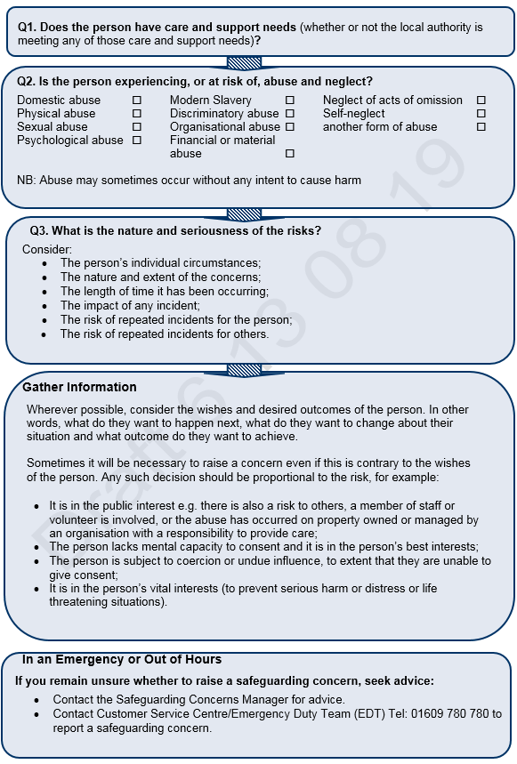
Key questions when deciding whether to report a safeguarding concern
Safeguarding Concerns Manager
Notes:
This is in the procedures

Slide 40
Provider Duties
Where a member of staff is alleged to have caused harm to an adult at risk, the organisation should:
  Take appropriate action to ensure the safety and wellbeing of the adult at risk
  Support both the adult at risk and the member of staff
  Follow their managing allegations against staff procedures
Employers should:
  Dealing with employment/disciplinary issues;
  Protecting the person whom the concern is about;
  Incident investigation;
  Assuring regulators and commissioners;
  Preventing recurrent risk, and risk to others;
  Reporting concerns.
Organisations should have in place procedures for managing allegations against staff
The adult should always be involved from the beginning of the enquiry unless there are exceptional circumstances that would increase the risk of abuse.
Notes:
What organisational policies do you have?
When were they last updated?
Do you know where to find them?
Do all managers in your organisation know?
Emphasis on care act is the employer must deal with disciplinary issues
We would want to know the risk assessment
Person alleged to have caused harm may also have care and support needs

Slide 41

Documenting the incident, actions and decisions – Defensible recording
Ensure that contemporaneous record are kept, including details of:
  The nature of the safeguarding concern/allegation
  The wishes and desired outcomes of the person
  The support and information provided to enable the person to make an informed decision
  An assessment of mental capacity, where indicated
  The decision of the organisation to raise a safeguarding concern (or not)
  Any original records made in the context of the above must be kept safely in case they are required at a later date by Police
  Assessment of risk and actions taken to reduce or manage risk
Notes:
Ensure all actions and decisions are fully recorded.
It is possible that your case records may be required as part of a Police investigation or Enquiry.
Be as clear and accurate as you can. Record the information about the concern/allegations, your decisions and any advice given to, or by, you in making these decisions.
How does your organisation record concerns
Do you use defensible recording?

Slide 42
Raising a concern
If the person you are concerned about is not in immediate danger, you should report the concern to the Local Authority via the Customer Service Centre
This is presently being developed but you will also be able to access the link from:
  https://safeguardingadults.co.uk/working-with-adults/raising-a-concern

Slide 43

Break
15 minutes

Slide 44
Stage 3 – Safeguarding response
Stage 4 – Outcome and closure including plan and review
Tool Kit
Questions
Stage 2 – Responding to the concern/information gathering
NYSAB Website

Slide 45
Stage Two – Responding to a concern/information gathering
Notes:
Responding to the concern is by the LA

Slide 46
Receipt of a Concern
Safeguarding concerns will be received within the Customer Service Centre (CSC)
Specialist Advisor in the CSC will triage the concern form, the day it is received
The Specialist Advisor will contact the person referring the concern where:
  Where there is a need to clarify points raised in the concern and what actions have been taken to manage risk, or
  Additional information is required, or
  To establish if an additional/alternative service is required.
  There is a need to verify if there is consent to share personal information.

Slide 47
Safeguarding Enquiry
The Specialist Advisor will establish if the concern raised appears to meet :
“s42 criteria”, i.e.
  Does the person appear to have care and support needs
  Does the person appear to be at risk of or experiencing abuse or neglect?
  Does the person appear to be unable to protect themselves from harm as a result of their care and support needs?
Or “Safeguarding other”
  Is the person experiencing or at risk of abuse or neglect?
  The person does not have care and support needs but has support needs
  Does the person or others appear to be at risk of harm?
Prevent Duty
  Will be progressed to the police under safeguarding in North Yorkshire

Slide 48
Customer Service Centre
Specialist Advisor receives concern
Concern appears to meet Section 42 criteria or Safeguarding Other
Care and Support Team
Locality Team
Concern does not meet Section 42 or Safeguarding Other criteria
Case closed to safeguarding and passed for either a request for service, provision of information, advice and guidance, signpost to another agency or no further action
Notes:
If it is prevent there is a prevent duty
Additional information about prevent in the concern form
Local authority has a wellbeing duty under the care act

Slide 49
Care and Support Team (Customer Service Centre)
When a (unknown or known closed) case is received by the Care and Support Team the Safeguarding Coordinator is responsible for allocating the case to an Enquiry Officer
The Enquiry Officer is responsible for:
  Responding to the concern
  Information gathering and
  Coordinating the response to assess immediate risk on the same working day it is received by the Care and Support Team
  The Enquiry Officer will make a recommendation to the Safeguarding Coordinator about what action should be taken
Cases will be reassigned to locality teams where:
  The adult at risk cannot be contacted, or
  A planning meeting or discussion is required

Slide 50
Locality Teams
For decisions about which locality team would receive the case the following should be considered;-
  Moving and handling issues identified may be managed by Independence.
For cases which are multi-agency, or where there is a criminal element identified or where the enquiry is likely to be long or complex and where organisational abuse is identified may be managed by Planned Care
When organisational abuse is indicated this must be discussed with a Safeguarding Coordinator
The response should be proportionate to the concern and consideration of risk to other people who may be using the service.

Slide 51
Locality Teams
Consider the person’s views and wishes established so far from the concern form
If the Section 42 duty is fulfilled - Assess outcomes and exit
Consider and implement any follow on actions as necessary
The duty continues if the adult is at risk of continued harm
Local Team assesses risk and ensures safety of the adult at risk within 24hrs
Decide on the proportionate response to the concern within 5 days
Notes:
In this part we need to express the need for those raising concerns to obtain and report on the views and wishes of the adult at risk which they obtained

Slide 52
Locality Teams
Concern received in locality team
Safeguarding Coordinator assigns to Enquiry Officer
Enquiry Officer gathers information and speaks to the adult at risk and/or their representative/advocate
Enquiry Officer finalises information gathering and makes recommendations
Recommendations agreed by the Safeguarding Coordinator
Exit Safeguarding
Planning Discussion
Planning Meeting

Slide 53
Keeping safe plan
A Keeping Safe Plan will usually be required where:
  Risk of abuse or neglect is ongoing, complex and unstable
  Risk of harm to the person or others is significant
  Other factors add to the complexity or uncertainty e.g. coercion, undue influence or duress
  Where the risk cannot be managed appropriately or adequately by other processes
The Keeping Safe Plan includes the following:
  Steps which support the person to keep safe in the future
  Provision of any support, treatment or therapy (including on-going advocacy)
  Modifications to service provision
Notes:
It is not a care and support plan

Slide 54
Writing the Keeping Safe Plan
The Keeping Safe Plan will be written with the person or their representative/advocate
It may be completed over the phone and followed by a face to face or as part of a meeting with others from their support network
The person or their representative/advocate must agree to the keeping safe plan
Needs to be in an accessible format

Slide 55
Stage Three – Safeguarding Response

Slide 56
Responding to a safeguarding concern
Where the concern cannot quickly and proportionately be ended, the Section 42 duty continues.
All enquiries require some degree of planning
This can range from a conversation between the Enquiry Officer and the person and/or their representative/advocate (Planning Discussion) or through to a multi-agency meeting (Planning Meeting)
Planning helps to determine roles and plan actions required to manage risk in the best way possible and to review appropriately

Slide 57
Planning Discussion
This may be
  Face to face
  By telephone, or
  Video conversation with Enquiry Officer, person and/or their representative/advocate.
A single agency response would be coordinated by the Enquiry Officer - This may also include phone calls to professionals or organisations who are involved in supporting the person
A Planning Discussion would be appropriate where the concern relates to a single agency response.
The response to any safeguarding concern should be the least intrusive option available, which is proportionate to the seriousness of the concern raised and the level of risk to the person/others.

Slide 58
Planning Discussion

Slide 59
Planning Meeting
This is a formal meeting chaired by the Safeguarding Coordinator for the relevant locality team (Independence, Planned Care, Mental Health or Sensory Service)
Safeguarding Support will provide minute taking support
Some people who have difficulties or lack mental capacity may require an advocate
Consideration must be given to planning the meeting to include the person and/or their representative/advocate and any access, support or communication needs that they may have
The adult at risk may state they do not want a formal response to safeguarding. The person’s wishes must be clearly recorded to inform and support a proportionate response which is taking in to account the person’s wishes and or those of their representative/advocate.

Slide 60
Planning Meeting

Slide 61
Planning Discussions and Meetings
Both meeting types consider:
  Current Risk Assessment
  The person’s views and wishes
  Person’s Mental Capacity
  Views of others
  Keeping Safe Plan
  Keeping the person updated
  Keeping the person alleged to have caused harm updated (if relevant)
  Further meetings
Discussion with the adult at risk on outcomes and safeguarding response should be done within 10 working days from the Initial Enquiry decision

Slide 62
Stage 4 – Outcomes, Closure including Keeping Safe Plan and Review

Slide 63
Stage 4: Outcome Review and Exit Safeguarding
An outcome review is undertaken by the safeguarding coordinator
This may be either a Multi-Agency Meeting or a range of activities which may include telephone/skype calls or face to face conversations
If the section 42 duty is fulfilled then exit safeguarding
What is the remaining level of risk to the adult?
Were the person’s outcomes achieved?
To complete within 12 weeks of the reporting of the concern.
Notes:
Each Local Authority will have its own Operational Guidance for staff to follow.

Slide 64
Closure and Exiting Safeguarding
Safeguarding Enquiries can exit when:
  The safeguarding process is no longer required
  The Keeping Safe Plan is no longer required
  When the adult is no longer at risk of abuse or neglect, or risk has reduced to the level that they can adequately and appropriately be managed or monitored through assessment and support planning processes
  A person with capacity who has care and support needs removes consent and there are no overriding public or vital interest considerations
Where criminal enquiry is likely be a long time before it is concluded, it is good practice to keep the safeguarding enquiry open the criminal enquiry has concluded. This will enable the person to consider their outcomes fully, which may include recourse to restorative justice
Where criminal enquiries are ongoing there may be a need to be a re-referral to the advocacy service to support the person

Slide 65
Stage 4 – Outcomes, Closure (including Keeping Safe Plan and Review)
Record outcomes
Discuss the MSP questions with the adult/their representative/advocate
Complete closure and exit safeguarding
Update on enquiry
Review Keeping Safe Plan

Slide 66
Making Safeguarding Personal Questionnaire
Whoever is managing the safeguarding episode will complete the MSP Questionnaire with the person or their representative/advocate
Was the individual or individual's representative asked what their desired outcomes were?
If outcomes were expressed, did the person or their representative feel that the desired outcomes were achieved?
To what extent was the individual or individual's representative involved in understanding and responding to acceptable levels of risk?

Slide 67
Making Safeguarding Personal Questionnaire
Whoever is managing the safeguarding episode will complete the MSP Questionnaire with the person or their representative/advocate
Did you understand why people did what they did to try to keep you safe?
Did you feel listened to during conversations and meetings?
How happy are you with the end result of what people did to try and keep you safe?
Do you feel that you are safer now because of the help from people dealing with your concern?

Slide 68
Resources for partners

Slide 69
New Procedures Toolkit
To assist North Yorkshire Safeguarding Adult Board (NYSAB) partners with the changes to the multi-agency approach to safeguarding adults a toolkit has been developed.
The toolkit provides partners with:
  A self-audit tool for organisations to measure the level of their readiness for the introduction of new Joint Multi-Agency Safeguarding Adults Policy and Procedures
  The audit tool includes a template action plan for organisations to complete following the self-audit
  The revised NYSAB Guidance on Developing Safeguarding Policies
  Links to the revised Joint Multi Agency Safeguarding Adults Policy and Procedures (West Yorkshire, North Yorkshire and the City of York)
The toolkit is available via the new website at https://safeguardingadults.co.uk/news/is-your-organisation-ready/

Slide 70
Self assessment and action plan
The toolkit incorporates a self-assessment and action plan for each agency to complete
The toolkit covers issues including:
  Organisation Policy Statement
  Review of Organisational Safeguarding Policies and Procedures
  Links to relevant legislation, policies and procedures
  Roles and Responsibilities
  Safe Employment
  Training, Professional Development and Supervision
  Access to Information
  Reports of concern or abuse
  Making Safeguarding Personal
  Advocacy
  Information Sharing
  Commissioned Services

Slide 71
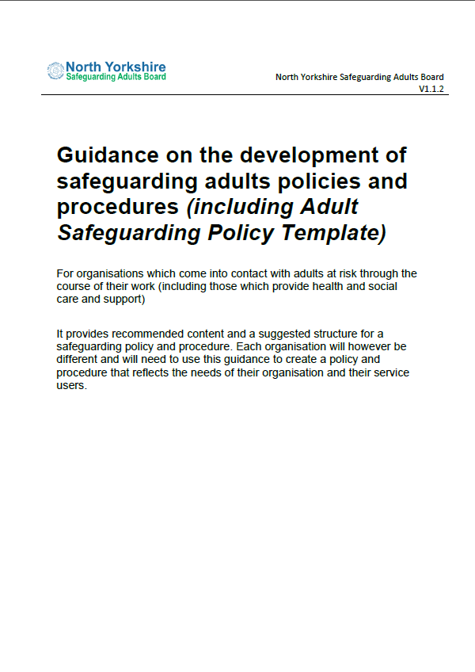
Local Safeguarding Policies
Each organisation should have their own policy and procedures which are available for staff and the public to view
The NYSAB has produced a helpful guidance document and template to assist organisation develop their own local policies
The document is available on the NYSAB website safeguardingadults.co.uk
Notes:
Multi-agency development
Ask question when did you last review your safeguarding policies
Do you ask staff to sign to say they have read them
Do staff know who is the lead for safeguarding
Do you include safeguarding on induction and throughout employment

Slide 72
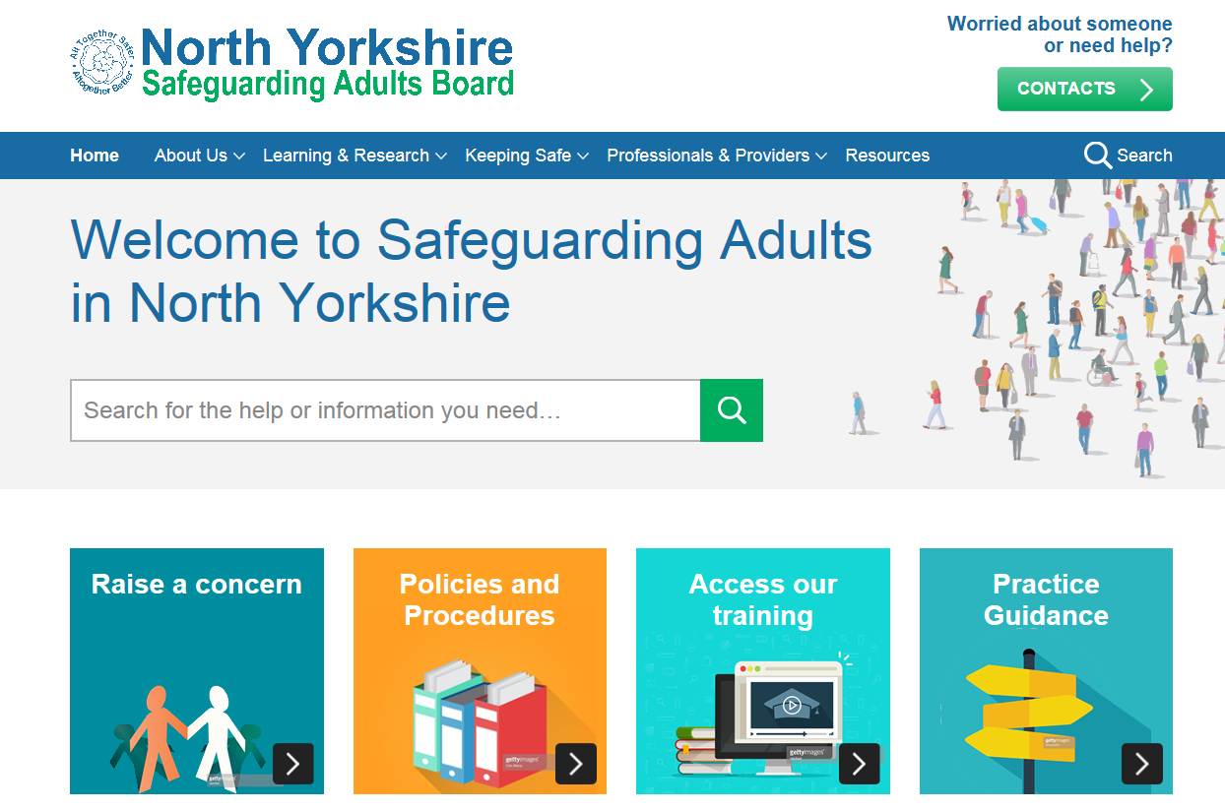
NYSAB Website
The NYSAB is your gateway to access resources to help you including:
  The Multi-Agency Safeguarding Adults Policy and Procedure
  Practice Guidance
  One Minute Guides
  Safeguarding training courses
  Learning from reviews
  This presentation
Visit:
  http://safeguardingadults.co.uk

Slide 73

Social Media
Follow us on Twitter to receive information on:
  New policies and procedures
  New practice guidance
  One Minute Guides (OMGs)
  Training
  Information on keeping safe, campaigns, awareness raising and
  Much, much more!
Visit:
  http://twitter.com/@nysab1

Slide 74

Any Questions?

