Slide 1
Working with adults who self neglect in the City of York and North Yorkshire

Slide 2
What is self-neglect?
‘A wide range of behaviour neglecting to care for one’s personal hygiene, health or surroundings and includes behaviour such as hoarding’ (Department of Health 2016)
Skills for Care identify three distinct areas that are characteristic of self-neglect:
Lack of self-care: Personal hygiene, nutrition, hydration or health
Lack of care of own environment: Leading to domestic squalor or elevated levels of risk in the domestic environment
Refusal of assistance that may make these things worse

Slide 3
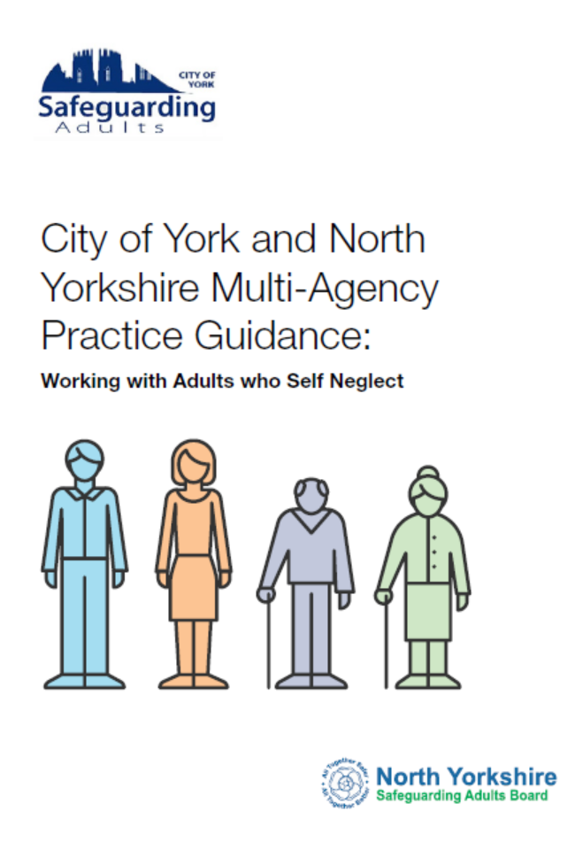
New guidance to support you
The new multi-agency guidance has been put together by the partners of the City of York and North Yorkshire Safeguarding Adults Boards.
The guidance is a practical tool to support in understanding how to spot the signs of self-neglect, how to build relationships and support those who may be self-neglecting, when and how to raise a concern and sets out a new multi-agency approach to supporting individuals.
The document is full of useful tips and information about where to get further support for yourself and those who you may be supporting.
You can download the guidance for free on both Board’s websites.

Slide 4
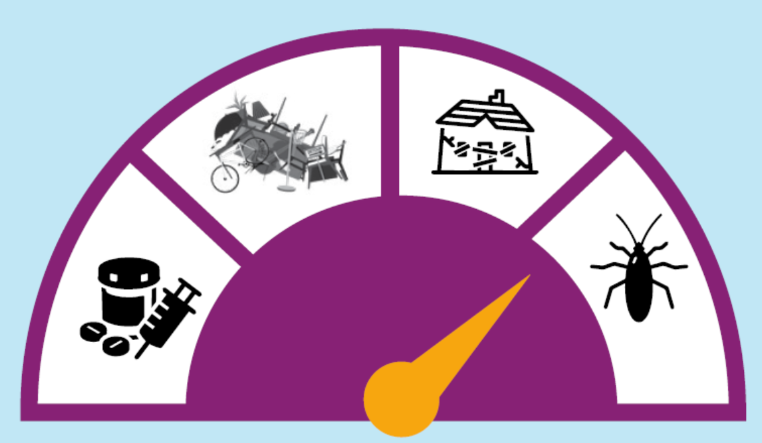
How to spot the signs of self-neglect
Everyone is different and may indicate they are self-neglecting in different ways. The below may be indicators of self-neglect:
Living in very unclean, sometimes verminous circumstances
Neglecting household maintenance creating hazards in and around the property
Obsessive hoarding
Poor diet and nutrition – for example no food in the fridge
Declining or refusing prescribed medication and/or support
Refusing access to property to health and/or social care staff
Refusal to allow access to those with an interest in the property
Unwilling to attend external appointments
Poor personal hygiene, poor healing
Isolation
Substance misuse
Increased debt
This is not an exhaustive list. If you have a concern that an adult is experiencing self-neglect you should always seek guidance at the earliest possible stage.

Slide 5
Hoarding
If a person exhibits hoarding behaviours it does not automatically mean they are self-neglecting, or that there is a safeguarding concern.
Hoarding is considered a significant problem if:
The amount of clutter interferes with every day living
The clutter is causing significant distress or negatively affecting the quality of life of the person or their family.
Hoarding disorders are challenging to treat as many may not see it as a problem, or have little awareness of how it is affecting them or others. Some may realise they have a problem, but feel ashamed or guilty about it.
It is important to encourage a person who is hoarding to seek help as their difficulties discarding objects may lead to loneliness and be detrimental to mental health as well as their physical health.

Slide 6
Why someone may hoard
The reasons why someone begins to hoard are not fully understood
This may be the symptom of another condition, for example someone with mobility problems may be unable to clear away clutter.
Mental health problems associated with hoarding include:
Severe depression
Psychotic disorders
Obsessive compulsive disorder
In some cases, hoarding is a condition in itself and often associated with self-neglect.
You should never just go into a person’s property and remove their items as this can make the situation worse. This should be done with the person, over time and with the right support in place.
Housing associations and councils with housing stock have their own hoarding policies and these should be referred to for further guidance.
The guidance document includes a Clutter Image Rating tool to support you when deciding the level of risk.

Slide 7
Assessing Mental Capacity
Mental capacity describes a person’s ability to make a specific decision at a specific time.
A person will be deemed to ‘lack capacity’ if at the time a decision is required they are unable to make that decision because of an impairment or disturbance in the functioning of the mind or brain. This may be temporary or permanent.
A person always has the right to make an ‘unwise’ decision. It should always be remembered that just because a person chooses to live a certain way does not mean they lack capacity or are self-neglecting.
Assessing capacity and trying to understand the reasons behind self-neglect is complex. It is usually best achieved by working with the person, their family and other organisations.
The Mental Capacity Act 2005 sets out the test for capacity. All assessments of capacity must be clearly documented.
If a person has substantial difficulty in understanding and engaging, the Local Authority must provide an appropriate person to support them or arrange and independent Advocate to support.

Slide 8
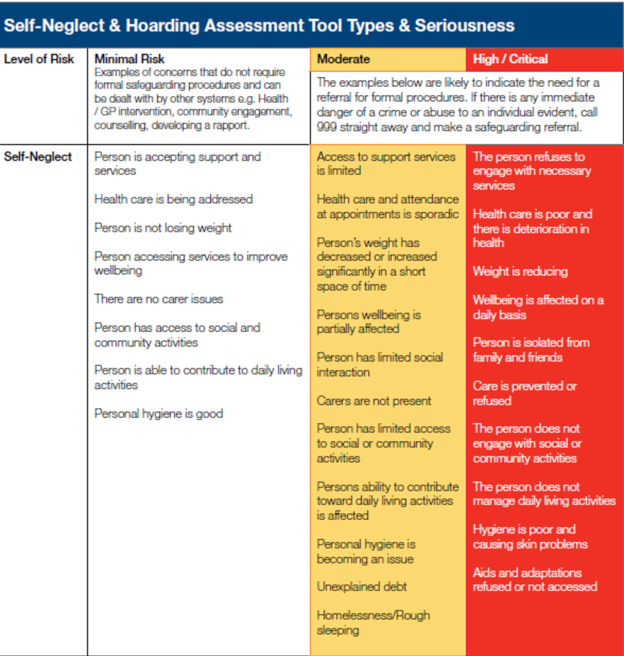
Assessing Risk
Before making the decision that a person is self-neglecting to the point of it being a safeguarding concern you should assess the risk to the individual and others.
The guidance provides a Risk Assessment Matrix to support in doing this.

Slide 9
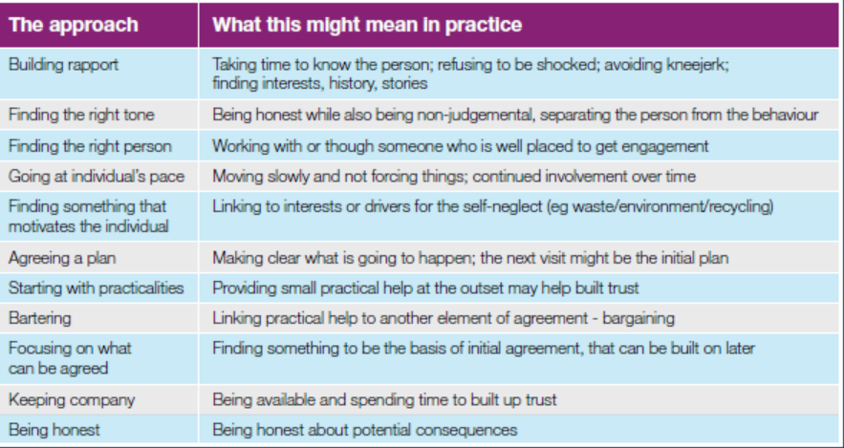
Building Relationships
Self-neglect and hoarding are often complex and emotional issues for people. The starting point for all interventions should be to encourage the person to do things for themselves.
The aim of building a relationship with an individual should be about assisting them to use their existing strengths and assets to manage their situation with the minimal amount of external support needed.

Slide 10
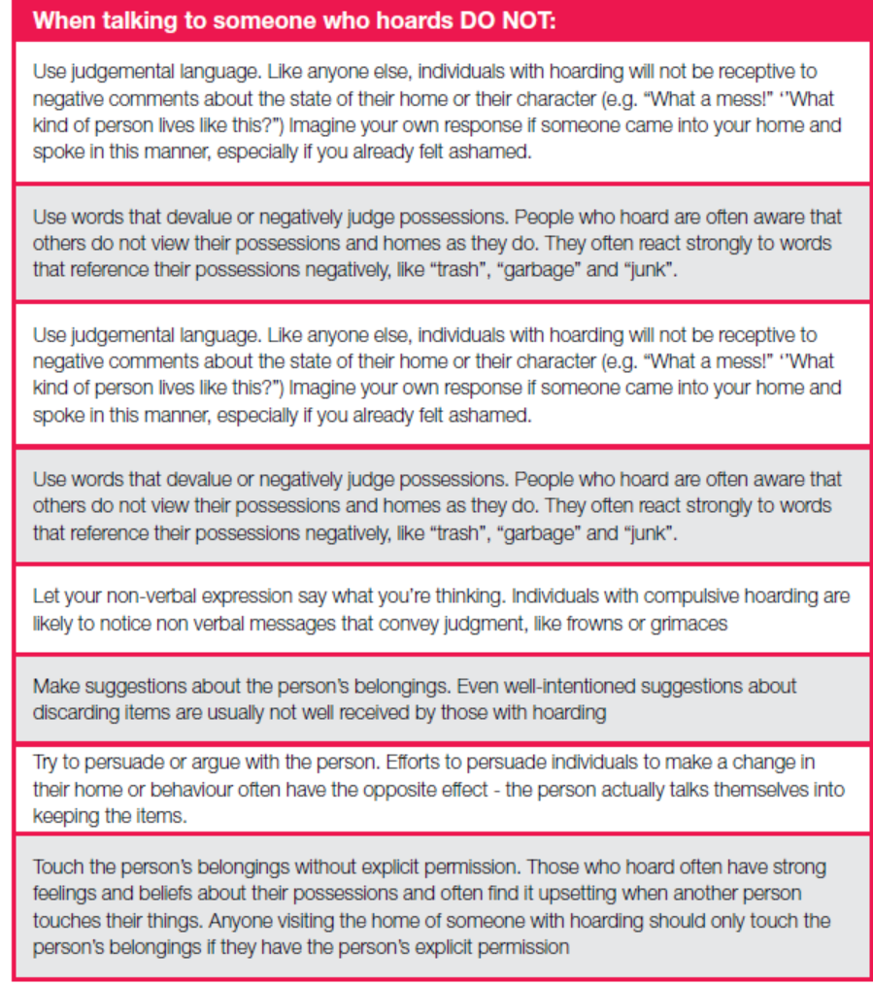
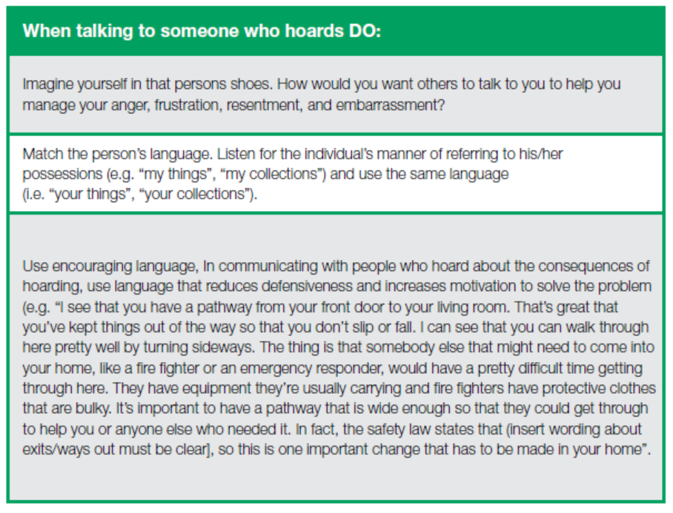
Communication Do’s and Don’t’ s

Slide 11
When is self-neglect a safeguarding issue?
Self neglect is a safeguarding issue when the person who self neglects:
Has needs for care and support (whether or not the Local Authority is meeting those needs) and:
Is experiencing or at risk of abuse, or neglect (including self-neglect)
As a result of those care and support needs is unable to protect themselves from either the risk of, or the experience of abuse or neglect.
It may also be a safeguarding concern if the adult who is self-neglecting is a carer for an adult at risk. In these cases always raise a safeguarding concern.

Slide 12
How to raise a concern
All concerns should be directed to the Customer Contact Workers in York or the Customer Service Centre in North Yorkshire.
They will triage the concern and decide whether it meets the Care Act criteria for a Safeguarding Enquiry.
You can find the contact details and copies of a Safeguarding Concern Form on both Boards as well as the Council websites.
If a person’s life is in immediate danger you should call 999.

Slide 13
What will happen with the concern?
Once a concern is received this may lead to a full Safeguarding Enquiry
They may decide that a multi-agency self-neglect meeting (MASM) may be more appropriate..
The MASM will be chaired by the agency with the most involvement/knowledge of the person and all relevant agencies should be invited.
In both processes the individual should be involved as much as possible.

Slide 14
Powers of Intervention
There are a number of legal powers to intervene if a person is self-neglecting and causing a risk to themselves and to others.
If the person has been found to lack capacity in relation to decisions around their self-neglecting behaviour then reference should be made to the Mental Capacity Act and the duty to act in the person’s best interests.
If the person has capacity, legal advice should always be sought in the first instance.
The guidance sets out a number of legal powers which may be used to protect the individual and others.

Slide 15
Further Support and Guidance
For further support and guidance, either for you or those you support download the self-neglect guidance document for free at either of the following:
North Yorkshire: http://www.safeguardingadults.co.uk
City of York: http://www.safeguardingadultsyork.org.uk
This includes further information about the areas covered in this presentation, together with details of organisations who can offer support.

