Slide 1
North Yorkshire Safeguarding Adults Board (NYSAB)
Quarter 2 Update

Slide 2
www.safeguardingadults.co.uk
Follow us on Twitter: @NYSAB1
1
Reconnect with communities in North Yorkshire to raise awareness and develop strategies to address and reduce risk of abuse
This priorities focus remains on safeguarding being everybody’s business and engagement and communication
2
Ensure multi agency safeguarding policies and procedures are in line with best practice – now and in the future
This builds on the current priority regarding policy and procedures.
NYSAB Strategic Priorities 2021 - 23
3
Ensure a stronger partnership approach and accountability for the prevention of abuse
This priority focuses on the effectiveness of partners joint working, relationships with the NYSCP and NYCSP and relevant connections with other areas that impact on adults for example modern slavery and suicide prevention
4
Ensure NYSAB is able to effectively adapt and respond to wider contextual changes affecting adult safeguarding
This includes LPS, Mental Health Act Review, LeDeR Implications as well as learning from SARs and much more

Slide 3
www.safeguardingadults.co.uk
Follow us on Twitter: @NYSAB1
NYSAB
Safeguarding Adult Review (SAR) Policy
The updated Safeguarding Adult Review (SAR) Policy was approved by the NYSAB at its June meeting and will now be used for all new SAR referrals.
The policy has the following updates:
More explicit in relation to what a SAR can do and, just as importantly, what a SAR cannot do
We have strengthened the section regarding family engagement
There is also information with regards to
consent whereby we receive a referral
for an individual who is still alive.
The policy is much more user friendly and
directive.
The new policy and referral form can be found here on the NYSAB website: https://safeguardingadults.co.uk/learning-research/nysab-learning/

Slide 4
www.safeguardingadults.co.uk
Follow us on Twitter: @NYSAB1
Mental Capacity Act (MCA) and Deprivation of Liberty Safeguards (DoLS)
In 2018 NYSAB went out to speak to as many people as possible
about the Mental Capacity Act.
One of the recommendations from this consultation was to ensure
that we empower and support individuals who lack capacity in
North Yorkshire as well as embedding the Mental Capacity
Act 2005.
We are now working as part of a task and finish group made up of representatives
from Carers Resource, Cloverleaf Advocacy, Dementia Forward and
KeyRing with support from Inclusion North and the self-advocates to co-produce
accessible information about ‘My Rights – The
Mental Capacity Act’ and ‘My Rights – Deprivation of Liberty Safeguards’.
The aim of these resources is to empower individuals to recognise when,
and how, to raise concerns, and also how the legislation can be used to
empower when it is implemented correctly.

Slide 5
www.safeguardingadults.co.uk
Follow us on Twitter: @NYSAB1
Organisational Safeguarding - Provider Concerns
(currently known as Collective Care)
The Collective Care policy is being reviewed with partner agencies and partner
organisations, this will be renamed Organisational Safeguarding – Provider
Concerns.
This document considers a range of issues about quality and safety, positive
practice, raising safeguarding concerns about organisational abuse and the
response to concerns about organisational abuse, and managing large scale
enquiries.
Partnerships between safeguarding, quality and safety functions, and their inter
dependent roles and responsibilities, towards providers will also be covered
within this policy.

Slide 6
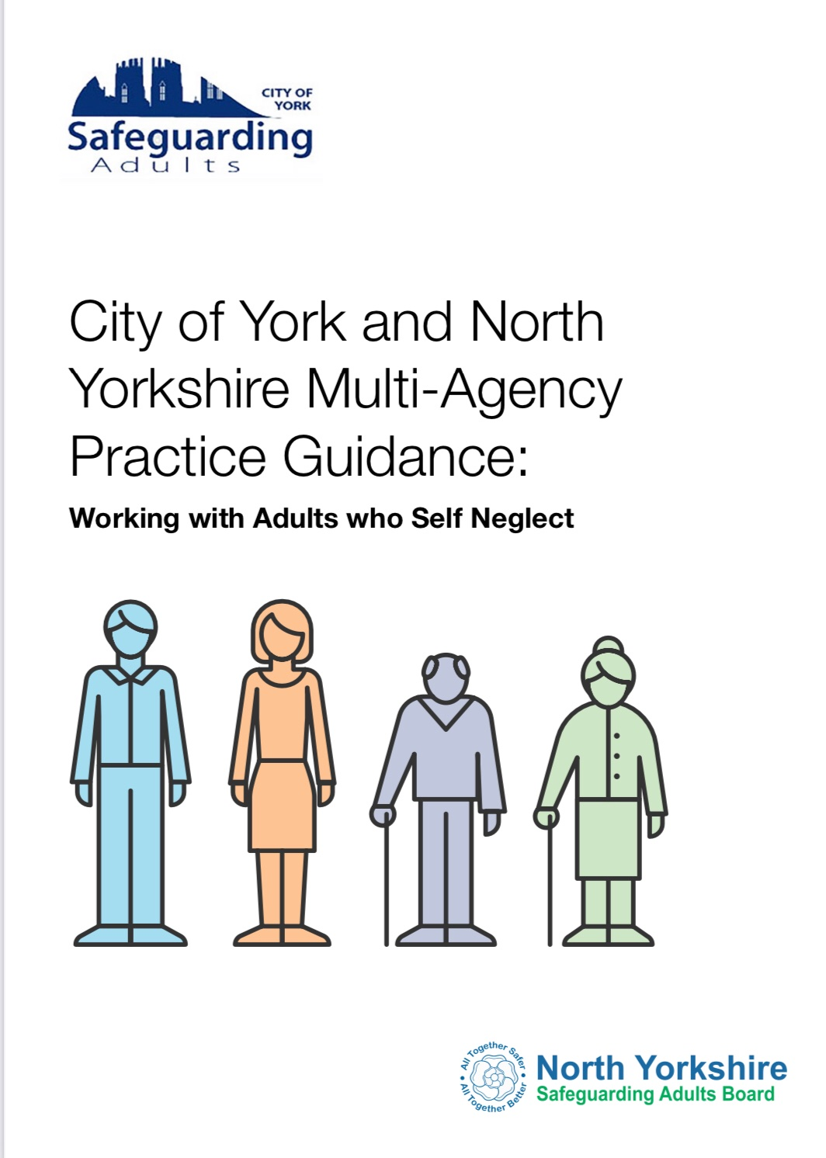
www.safeguardingadults.co.uk
Follow us on Twitter: @NYSAB1
Whilst we work to operationalise the self neglect procedures in North Yorkshire we’re asking that you, your organisations and teams familiarise yourselves with the practice guidance, available on our website, in readiness for implementation https://safeguardingadults.co.uk/working-with-adults/nysab-procedures/self-neglect/
The City of York and North Yorkshire Self Neglect document outlines Practice Guidance for dealing with issues and concerns of self-neglect in relation to adults with care and support needs.
The Guidance should be read alongside the Joint area Multi-Agency Safeguarding Adults Policy and Procedures (West Yorkshire, North Yorkshire and City of York)
Also available is the Multi Agency Self-Neglect Meeting (MASM) pro forma, details of which can be found within the practice guidance – https://safeguardingadults.co.uk/wp-content/uploads/2020/04/MASM-Proforma.pdf
City of York and North Yorkshire
Self-Neglect Practice Guidance

Slide 7
www.safeguardingadults.co.uk
Follow us on Twitter: @NYSAB1
Risk Notification Return (RNR) Guidance Tool
The Risk Notification Return RNR Guidance Tool will assist providers
in identifying situations that may occur whilst carrying out a regulated
service/activity or this may be within an unregulated activity such as day
support service, that requires notification to the Quality and Market
Improvement Team via completion of the Risk Notification Return.
This Guidance Tool does not aim to set a rigid criteria for intervention
or replace professional judgement. Providers must seek advice from
their organisations Safeguarding Lead if they are unsure about
whether an incident is safeguarding. Reporting a safeguarding
concern by following the relevant organisations Safeguarding Guidance
and access the safeguarding concern form here:
https://www.northyorks.gov.uk/safeguarding-vulnerable-adults
Links to the RNR Guidance Tool & Return Form:
Risk Notification Return (RNR) Guidance Tool
Risk Notification Return Guidance Tool | North Yorkshire County Council
Risk Notification Return Form
https://www.northyorks.gov.uk/tools-procedures-and-guidelines-adult-social-care-services-providers
Notes:
The following areas below, are covered in the guidance.
· Falls
· Incidents between adults at risk (no requirement to submit an RNR)
· Nutrition and hydration
· Pressure area care (no requirement to submit an RNR)Keep free
· Medication errors
· Missed home care visit
· Moving and handling
· Poor Discharge/Transfer of Care (no requirement to submit an RNR)
· Financial concerns (no requirement to submit an RNR)
· Environmental
· CQC Notification(s)
· Non-regulated notifications
· Accidents, Incidents and Serious Incidents (no requirement to submit an RNR)

Slide 8
www.safeguardingadults.co.uk
Follow us on Twitter: @NYSAB1
One Minute Guides – https://safeguardingadults.co.uk/working-with-adults/one-minute-guides-omg/
Keeping Safe Resources - https://safeguardingadults.co.uk/keeping-safe/easy-read-guides/
Training - https://safeguardingadults.co.uk/learning-research/training-courses/
NYSAB Procedures - https://safeguardingadults.co.uk/working-with-adults/nysab-procedures/
Resources
& Keeping up to date with the NYSAB
Twitter
Newsletter
Website
www.safeguardingadults.co.uk/nysab-newsletter
www.safeguardingadults.co.uk
www.twitter.com/nysab1

Slide 9
Resources
& Keeping up to date with the NYSAB

Slide 10
Community Safety Partnerships are under a statutory duty to work together to:
Reduce reoffending
Tackle crime and disorder
Tackle anti-social behaviour
Undertake Domestic Homicide Reviews
Areas for Delivery and Development (2018-22)
NYCSP has agreed the following priority areas for delivery
Partnership development
Community Safety Hubs
Domestic Abuse (including scoping Sexual Violence and Trauma)
Serious and Organised Crime (early intervention and prevention)
Hate Crime and Community Cohesion
Resources
& Keeping up to date with the NYSAB

Slide 11
Community Safety Hubs
Overarching work streams for JCG 2021/22:
Development of Opportunities (Barriers to working, Early Action Together - EAT Project, Local Government Reorganisation, New PCC)
Finances (Business Support, Hub funding, Commissioned services, Joint funding bids, Bids to PCC)
General Administration (Terms of Reference, Partner models, ways of working)
Performance Management (Interventions, ORCUMA, KPI for CSP)
Countywide Meetings (attendance across JCG meetings, Safeguarding, Prevent/Contest)
Training (Mental Health, ASB, Orcuma, Job Shadowing, problem solving, other)
Legislation (Police, Crime, Sentencing and Courts Bills, Local Government Reorganisation)
Communication (Partner/Briefings Communities, Funding Bodies
Community Safety Hub Survey: Tell us how we are doing!
The deadline is 23 July 2021
https://wh1.snapsurveys.com/s.asp?k=162082836122
Resources
& Keeping up to date with the NYSAB

Slide 12
Domestic Abuse
Safeguarding Week 2021
‘Hard to Help’ Home | Humankind (hardtohelp.org)
Domestic Abuse Act 2021
Legal definition of domestic abuse
Domestic Abuse Commissioner- Nicole Jacobs
Safe Accommodation Duty
Recognises children as victims
Resources
& Keeping up to date with the NYSAB
Notes:
SGW Notes- Domestic abuse has featured significantly throughout the events for safeguarding week. With a number of DA related webinars, DA charter for employers, the impact of DA on children and young people,
‘Hard to Help’ resources and DA in rural areas)
Hard to Help Notes- On-line resource for working with perpetrators, commissioned project by the Office of the Police, Fire and Crime Commissioner. Resource, training, toolkit portal. Offering free training for anyone working in public services in North Yorkshire and York. It aims to give practitioners confidence in spotting domestic abuse. It includes bite size modules on links to alcohol, drugs and mental health. It aims to ‘upskill’ practitioners, to work with perpetrators who want support and are willing to access perpetrator support services (+ Choices))

Slide 13
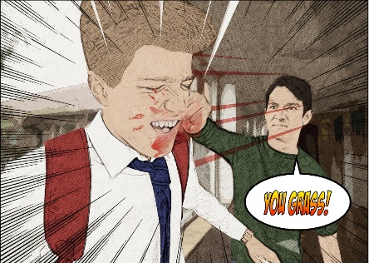
Hate Crime and Community Cohesion
Hate Crime Working Group is now known as ‘Inclusive Communities’ Joint Coordinating Group and is a sub group of the NYCSP.
Positive Communities Project: KYMSgame, Hurt by Hate and Wake up Call
North Yorkshire Safe Places: Safe places | North Yorkshire County Council
Hate Crime Awareness Week (9-16th October): Joint campaign across partnerships
& Boards with local activity
Hate Crime Awareness Sessions for practitioners
Notes:
Positive Communities Project is funding through the OPFCC to review the resources available for education settings to ensure a more streamline approach in the delivery of such projects which focus on raising awareness of Hate Crime whilst also challenging any prejudice views and behaviours. These resources are delivered by North Yorkshire Youth Commission and North Yorkshire Youth.
NY Safe Places A safe place is where anyone who might need a little more help and support when they are out and about in the community can call in to get assistance. Members of the scheme carry a 'keep safe' card and may have a wristband. On the card there is a call centre number that can be contacted by the safe place to check the person's details. The call centre will then contact the person's responders to make sure someone who knows them the best can come to take them home.

Slide 14
Contact
Lesley Gray, Principal Safer Communities Officer, NYCC
Lesley.gray@northyorks.gov.uk

Slide 15
North Yorkshire Safeguarding Children Partnership
Q2 Update
28 June 2021

Slide 16
Being Young in North Yorkshire 2021-2024
Theme One
A safe life
Protected from harm
Live in safe communities
Supported by Family networks
Theme Two
A happy family life
Families are empowered to be resilient
School Years are happy
Community Support Networks help families thrive
Theme Three
A healthy life
Promote health and wellbeing through positive choices
Improve Social, Emotional and mental Health
Reduce health inequalities
Theme Four
Achieving in life
Ensure children are ‘School Ready’
Raise Achievement levels for all
Create environments where children have aspirations for their future
Our vision is that:
All children and young people are safe, happy, healthy and able to achieve in North Yorkshire

Slide 17
New Threshold Guidance
Support those working with children and young people
Designed to help get the right help at the right time
To be used to aid decision making to determine next steps
www.safeguardingchildren.co.uk/professionals/practice-guidance/threshold-document
Notes:
The “Framework for decision-making: Right help, at the right time by the right person” has been developed to help and support practitioners working with children across all agencies and organisations, when faced with a decision about the safety and wellbeing of a child or young person. It is a collaborative approach to support and drive our shared ambition of the right help, at the right time from the right service and, importantly, from the right person.
The guidance sets out which agencies and which levels of intervention may be needed to keep children safe, support families, build on their strengths, promote resilience and overall outcomes for children, young people and their families.
The Framework should be used by practitioners to aid decision making and identify next steps but not replace the conversations when concerns about a child or young person are raised. All practitioners should use their safeguarding leads and Early Help Consultants for support, guidance and reflection.
The Framework supports practitioners with thresholds and also embeds the North Yorkshire’s relationship based model of practice using a Signs of Safety methodology to understand past and potential harm, along with safety and strengths to develop what needs to happen next. This document sits alongside, and is complimentary to, existing NYSCP Procedures.

Slide 18
Hidden Harm
The NYSCP has relaunched it’s Hidden Harm Campaign
A new podcast has been produced by the NYSCP to help explain to a wider audience what hidden harm is and what to do if you have a concern (available here)
Resources are available on the NYSCP Website

Slide 19
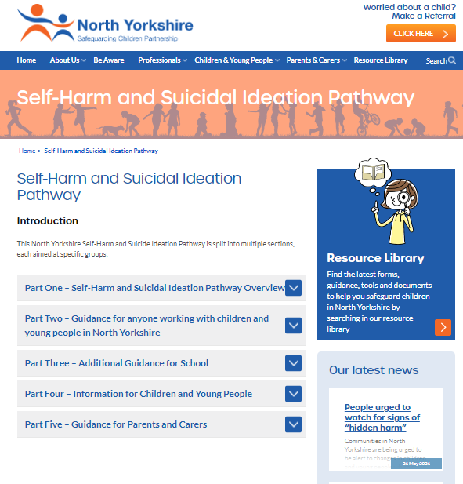
Self-Harm and Suicidal Ideation Pathway
The purpose of the pathway is to improve the referral processes, coordination, support and treatment that is provided to children and young people who self-harm and/or experience suicidal ideation
This pathway is primarily for frontline staff working with children and young people who:
Identify themselves as using self-harm as a coping strategy
Require support as a result of disclosing self-harm, suicidal ideation and or previous suicide attempt
Pathway is set out in 5 sections
See more at:
https://www.safeguardingchildren.co.uk/shsip
Notes:
Section 1 – Pathway
Section 2 – Workforce
Section 3 – School specific information
Section 4 – Children’s Mental Health Section
Section 5 – Advice for Parents and Carers
All delivered through safeguardingchildren.co.uk – no pdf download like last pathway

Slide 20
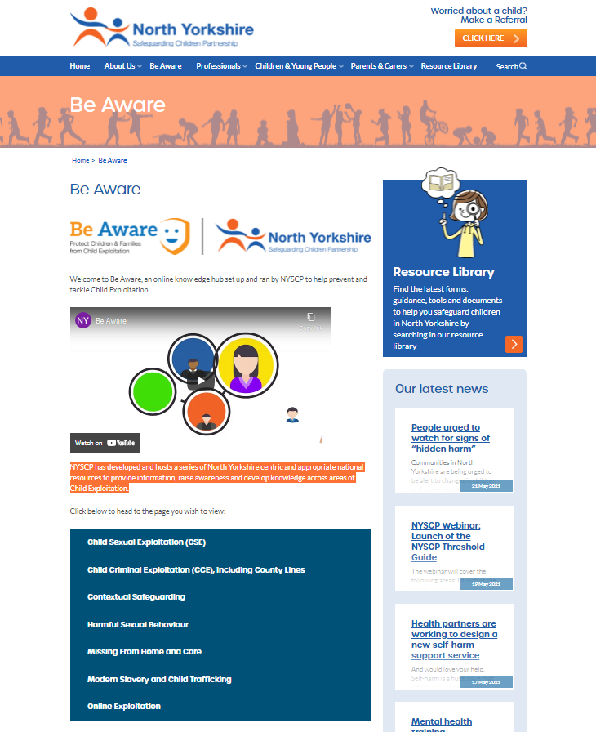
Be Aware
NYSCP has developed resources to provide information, raise awareness and develop knowledge across areas of Child Exploitation
Key areas covered by the knowledge hub include:
Child Sexual Exploitation (CSE)
Child Criminal Exploitation (CCE), including County Lines
Contextual Safeguarding
Harmful Sexual Behaviour
Missing from Home and Care
Modern Slavery and Child Trafficking
Online Exploitation
For more information visit: https://www.safeguardingchildren.co.uk/beaware

Slide 21
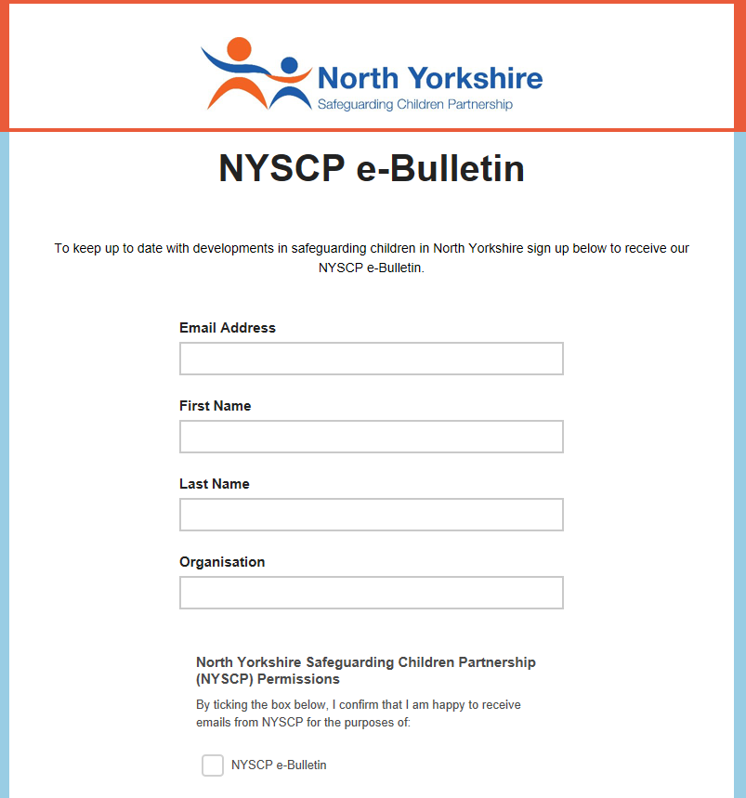
Keep up to date with NYSCP
Free NYSCP Monthly
e-Bulletin Sign Up here
Follow us on twitter @nyscp1
Follow us on Facebook @nyscp1

