Slide 1
North Yorkshire Safeguarding Adults Board (NYSAB)
Quarter 3 Update

Slide 2
www.safeguardingadults.co.uk
Follow us on Twitter: @NYSAB1
‘Anne’ SAR
A 6 month delivery report was shared with the Board on the progress of the
SAR and its recommendations and subsequent action plan
This delivery report along with a 7-minute-briefing from the SAR will be
shared shortly and will be made available here on the NYSAB website:
https://safeguardingadults.co.uk/SAR-Anne
Safeguarding Adult Review (SAR) Updates
Joint SAR
A practitioners learning event took place in relation to the joint SAR which is
being undertaken with North Yorkshire Safeguarding Children
Partnership (NYSCP)
The event was an opportunity for practitioners from both adult and children services to discuss the case and collaboratively identify areas and recommendations for improvement.
Following this, the independent author will now work on the first draft of the SAR report before it is shared with the SAR panel and agency leads for comments and feedback.
We are aiming to publish the report and recommendations in the New Year

Slide 3
www.safeguardingadults.co.uk
Follow us on Twitter: @NYSAB1
To coincide with World Suicide Prevention Day, the NYSAB, NYSCP and NYCSP
hosted a Suicide Prevention webinar on Thursday 9th September
The hour long webinar featured a small panel chaired by Claire Robinson, Health Improvement Manager for Public Health and Suicide Prevention lead for North Yorkshire.
The panel answered questions, discussed services and support available, action that can and needs to be taken - particularly in relation to training and the personal and professional responsibility of people to help address suicide prevention.
The mix of panellists ensured we heard different perspectives on a key issues whilst highlighting a collective aim to address what we can to prevent suicide - creating hope through action
Suicide Prevention
Webinar
A recording of the webinar can be found here:
https://www.youtube.com/watch?v=kg86YcxEoKA
Links to the resources, training and support available
can all be found here:
https://safeguardingadults.co.uk/suicide-prevention
Notes:
We will be reviewing feedback from attendees as well as holding a “mop up” session to discuss future webinars on suicide where we will look to highlight specific topics such as the link and work between suicide prevention and mental health
Suicide Prevention is also part of the NYSAB Strategic Priorities for 2021 – 23 and forms part of our priority in relation to working with partners and partnerships on key areas of focus.
Take the training – Save a life! We are encouraging people to undertake the free Suicide Awareness Training delivered by Zero Suicide Alliance which is available to access here: https://relias.co.uk/hubfs/ZSA-FullTraining-10012020/story_html5.html?utm_source=Relias&utm_campaign=Training-Landing-Page…
And don’t forget you can still access the recording of and slides from the Suicide Prevention presentation given by Pat Sowa as part of Safeguarding Week 2021 here: https://safeguardingadults.co.uk/suicide-prevention

Slide 4
www.safeguardingadults.co.uk
Follow us on Twitter: @NYSAB1
At the Board meeting in September, Dr Joy Shacklock and Colin Dales delivered presentations on Safeguarding and Homelessness and Safeguarding in Housing Settings respectively
The presentations looked at:
The support available for people with complex needs who are homeless;
The safeguarding issues people who are homeless face such as self-neglect and the risk of abuse;
The impact of Adverse Childhood Experiences (ACEs) on those who are homeless and;
Accommodation and Housing
Areas for discussion and further consideration for the Board moving forward include:
Having a more joined up approach between agencies such as the voluntary sector, probation and the homelessness group
Link in with the work and recommendations of the SARs
A dedicated session at the Executive meeting in the New Year will take place to discuss further what the SAB can do to address housing and homelessness.
Safeguarding, Homelessness and Housing
Notes:
In light of the recent recommendation from the ‘Anne’ SAR, as well as the learning from recent SARs and SAR referrals, housing and homelessness is a strategic priority for the Board.

Slide 5
www.safeguardingadults.co.uk
Follow us on Twitter: @NYSAB1
Organisational Safeguarding
Work continues to review the Organisational Safeguarding – Provider Concerns (currently known as Collective Care)
Once the work is complete, partners will be notified and the policy will be published on the NYSAB website
Publication of NYSAB Annual Report 2020-21
The NYSAB Annual Report for 2020-21 will be published in mid October giving an overview of the work we have achieved over the last year and what we aim to do in 2021-22
To coincide with our commitment to produce accessible information, we will produce an easy read summary and audio version of the main report
The reports will be available here: https://safeguardingadults.co.uk/annual-reports
NYSAB Development Day
The NYSAB Development Day will take place on Monday
29th November where the Board will:
Reflect on the lessons learnt from Covid
Discuss inequalities highlighted throughout Covid
Reflect on the response and good practice during
the pandemic
Review the strategic priorities
The next quarter…

Slide 6
www.safeguardingadults.co.uk
Follow us on Twitter: @NYSAB1
One Minute Guides – https://safeguardingadults.co.uk/working-with-adults/one-minute-guides-omg/
Keeping Safe Resources - https://safeguardingadults.co.uk/keeping-safe/easy-read-guides/
Training - https://safeguardingadults.co.uk/learning-research/training-courses/
NYSAB Procedures - https://safeguardingadults.co.uk/working-with-adults/nysab-procedures/
Resources
& Keeping up to date with the NYSAB
Twitter
Newsletter
Website
www.safeguardingadults.co.uk/nysab-newsletter
www.safeguardingadults.co.uk
www.twitter.com/nysab1

Slide 7
Resources
& Keeping up to date with the NYSAB

Slide 8
Community Safety Partnerships are under a statutory duty to work together to:
Reduce reoffending
Tackle crime and disorder
Tackle anti-social behaviour
Undertake Domestic Homicide Reviews
Areas for Delivery and Development (2018-22)
NYCSP has agreed the following priority areas for delivery
Partnership development
Community Safety Hubs
Domestic Abuse (including scoping Sexual Violence and Trauma)
Serious and Organised Crime (early intervention and prevention)
Hate Crime and Community Cohesion
Resources
& Keeping up to date with the NYSAB

Slide 9
Domestic Abuse update
Need and demand remains high
List of commission services Domestic Abuse | North Yorkshire Partnerships (nypartnerships.org.uk)
Nicole Jacobs – the ‘tail’ of the pandemic’s impact will extend ‘way beyond’ the easing of lockdown
MARAC pilot – weekly MARACs
Domestic Abuse Act 2021 – Focus on meeting the Statutory duties places on the Las (Impact on Partnership arrangements)
Needs Assessment (Safe accommodation) completed.
Strategy must be published by 31st October 2021
Resources
& Keeping up to date with the NYSAB

Slide 10
HCAW Communication plan coordinated through the Inclusive Communities JCG #HelpNotHateNY2021
Resources
& Keeping up to date with the NYSAB
Training opportunities :
The All About Respect bystander programme aims to empower individuals to be part of the solution in stopping and preventing harassment. This is a ‘Train the Trainer’ event.
North Yorkshire Police Prevent Team will be giving a presentation highlighting the dangers of vulnerable people being drawn into terrorism or being exposed to extreme narratives, with a particular focus on the signs and symbols associated with the groups who fuel online hate and the referral process for North Yorkshire.
Hate Crime Awareness Raising Session: a basic understanding of Hate Crime in North Yorkshire. The session will cover the different characteristics of Hate Crime, what is a hate crime and what is a hate crime incident, how to report hate crime and what support is available.
Events and Latest News | North Yorkshire Partnerships (nypartnerships.org.uk)
Hate Crime and the Hate Crime Working Group | North Yorkshire Partnerships (nypartnerships.org.uk)

Slide 11
Coordinated Communication Plan for the Modern Slavery Partnership #unlockslavery2021
Modern Slavery Awareness Session 18th October 2021: The charitable organisation ‘Hope for Justice’ will provide attendees with a basic understanding of Modern Slavery and its impact in North Yorkshire.
Events and Latest News | North Yorkshire Partnerships (nypartnerships.org.uk)
Modern slavery - North Yorkshire Police | North Yorkshire Police

Slide 12
North Yorkshire Police & Crime Plan 2021 – consultation
The plans being developed and consulted on are:
Police and Crime Plan 2021-2024 – sets out the vision and priorities for North Yorkshire Police, community safety and victims’ rights, as well as the objectives and ambitions that the Chief Constable will be held to account against.
Fire and Rescue Plan 2021-2024 – sets out the strategic vision, priorities and objectives for North Yorkshire Fire and Rescue Service for how it will better respond to the need of our communities.
Closes 7th November
Tell Philip - North Yorkshire Police, Fire & Crime Commissioner asks for your views (northyorkshire-pfcc.gov.uk) /

Slide 13
Contact
Lesley Gray, Principal Safer Communities Officer, NYCC
Lesley.gray@northyorks.gov.uk
Follow us on Twitter: @NYorksCSP

Slide 14
North Yorkshire Safeguarding Children Partnership
Autumn Update
September 2021

Slide 15
Framework for Decision Making
Identifies levels of support for children and families to:
Build on strengths
Promote resilience, and
Overall outcomes for children and young people
For use by practitioners to aid decision making and identify next steps
It does not replace conversations when concerns about a child or young person are raised
For more see our YouTube video or visit https://www.safeguardingchildren.co.uk/professionals/practice-guidance/threshold-document/
Notes:
The guidance sets out which agencies and which levels of intervention may be needed to keep children safe, support families, build on their strengths, promote resilience and overall outcomes for children, young people and their families.
The Framework should be used by practitioners to aid decision making and identify next steps but not replace the conversations when concerns about a child or young person are raised. All practitioners should use their safeguarding leads and Early Help Consultants for support, guidance and reflection.

Slide 16
Being Young in North Yorkshire 2021-2024
Theme One
A safe life
Protected from harm
Live in safe communities
Supported by Family networks
Theme Two
A happy family life
Families are empowered to be resilient
School Years are happy
Community Support Networks help families thrive
Launches
1 October 2021
Theme Three
A healthy life
Promote health and wellbeing through positive choices
Improve Social, Emotional and mental Health
Reduce health inequalities
Theme Four
Achieving in life
Ensure children are ‘School Ready’
Raise Achievement levels for all
Create environments where children have aspirations for their future
Our vision is that:
All children and young people are safe, happy, healthy and able to achieve in North Yorkshire
Notes:
Being Young in North Yorkshire 2021 will launch on 1 October 20221
It sets out the four key themes for the NYSCP, these being A safe life, a happy family life, A healthy life and achieving in life

Slide 17
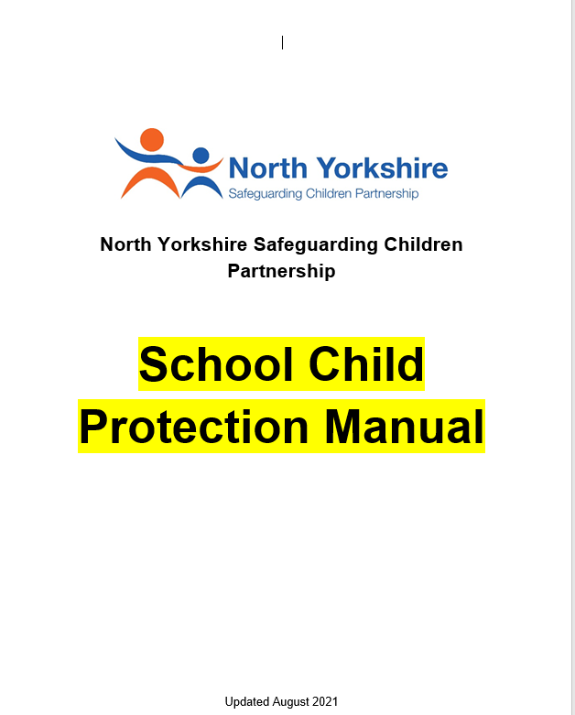
School Child Protection Manual, Sept 2021
Replaces the previous School Child Protection Policy Template
Content updated for Keeping Children Safe in Education, Sept. 2021
The new manual is split into two sections:
Section A – Template Child Protection Policy for schools
Section B – Practice Guidance for Schools
To access the manual visit: https://www.safeguardingchildren.co.uk/professionals/practice-guidance/sample-template-school-child-protection-policy/
Notes:
The new School Child Protection Manual has been developed to replace the previous School Child Protection Policy Template
It is split into two sections – the first the template policy for schools, the second individual draft guidance
This is now available to schools

Slide 18
School Safeguarding Audit 2020/2021
99.7% of schools responded to the audit:
213 maintained primary schools
17 maintained secondary schools
93 primary academies
26 secondary academies
11 special schools
5 Pupil Referral
19 independent schools
Key areas for improvement included across schools included
Record keeping (e.g. single central record, safeguarding concerns)
Training (e.g. general safeguarding awareness, safer recruitment)
Policies in place (e.g. behaviour, social media, etc.)
Governance arrangements
Reporting of hate crimes
Ensure pupils know who to talk to if they had a concern
Physical security controls (e.g. managing pedestrians and vehicles included buses and coaches, receiving and collecting students)
Health and safety risk assessments and maintenance schedules
For more information visit https://www.safeguardingchildren.co.uk/professionals/learning-for-professionals/
Notes:
The results of the School Safeguarding Audit for 2020/2021 have been reported and a new 7 point beefing has been produced
Findings a similar to that of the previous audit although there are a few new themes
For more download our new 7 point briefing available from our website at the link on screen

Slide 19
Annual Reports
For more information visit www.safeguardingchildren.co.uk
Notes:
It is annual report time and the new NYSCP Scrutineer Annual Report has been produced and the Child Death Overview Panel Annual Report
For more information visit our website

Slide 20
MACE
MACE continues to be well attended in local areas
Some schools attended during the school holidays
Increasingly seeing the impact of peer on peer exploitation
This year so far there have been 12 detailed MACE Level 2 mapping meetings to understand the links between children, adults of concern and locations that may pose a risk to young people.
Continued good information sharing.
Focus for the next six months on the ‘so what’
What as a collective partnership do we need to put in place to increase safety for these young people.

Slide 21
New publications for your information
Tri.X procedures have been updated and changes are live
Managing Allegations Against Those Who Work or Volunteer With Children (updated)
Whistleblowing Practice Guidance (updated)
Concealed, Denied or Late Presentation of Pregnancy Practice Guidance (new)
Out of Area Young People Arrested who appear at risk of Criminal Exploitation Practice Guidance (new)
Professional Resolutions Practice Guidance (updated)
NYSCP Standards and Criteria (updated)
Missing from Home and Care 7 point Briefing
Notes:
Numerous document have been updated
All are available from the Professionals area of our website

Slide 22
Op Choice
The vision is that Operation Choice will provide a platform to prevent the criminalisation of young people, keep young people safe and potentially prompt a culture change around using drugs.
The podcast is available from Spotify, Breaker, Google Podcasts, Pocket Casts and RadioRepublic
Find out more on our latest podcast and visit https://anchor.fm/north-yorkshire-safeguarding-children-partnership
Notes:
Our next podcast is about to launch which explores Operation Choice which aims to prevent criminalisation of young people and keep people safe from drugs, potentially changing the culture around drugs use

Slide 23
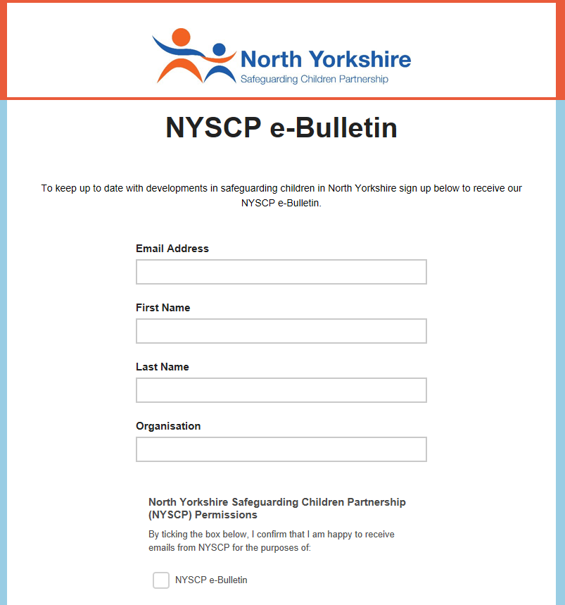
Keep up to date with NYSCP
Free NYSCP Monthly
e-Bulletin Sign Up here
Follow us on twitter @nyscp1
Follow us on Facebook @nyscp1
Notes:
Don’t forget to sign up to our monthly e-bulletin, and follow us on social media via Twitter and Facebook

Slide 24
If you would like more information about the local safeguarding partnerships please see the contact details below for the Chair and Business Support of each LSP
Harrogate and Craven
Chair: Stephen.Thomas@northyorkshire.police.uk
Business Support: Harriet.Dewhirst@northyorks.gov.uk
Scarborough, Whitby and Ryedale
Chair: Sandra.Rees@scarborough.gov.uk
Business Support: Andrea.Hayes1@northyorks.gov.uk / Lauren.Young@northyorks.gov.uk
Hambleton & Richmondshire
Chair: Helen.Williams213@nhs.net
Business Support: Rachel.Bentley@northyorks.gov.uk
Selby
Chair: SSweeting@selby.gov.uk
Business Support: Susan.Watson@northyorks.gov.uk
You can also find more information about the LSPs, including the terms of reference and copies of these quarterly updates here: https://safeguardingadults.co.uk/about-us/lsps/
Contact the LSPs

