Slide 1
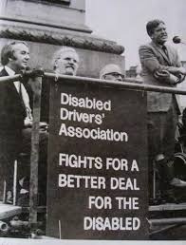
Disability History Month
18th November - 18th December 2021

Slide 2
What is UK Disability History Month?
Annual event creating a platform to focus on the history of disabled people's struggle for equality and human rights.
Themes for UKDHM 2021 are Disability and Hidden Impairment and Disability, Sex and Relationships.
Every year on the 3rd December during UKDHM, the International Day of People with Disabilities is marked. This year's theme is "Fighting for rights in the post-COVID era"

Slide 3
UKDHM is important because it
highlights the history of the fight for disabled rights and the ongoing struggle for equality;
helps to create greater understanding of the barriers in society that disabled people face;
highlights the diversity of experiences of disabled people

Slide 4
Important facts

Slide 5
There are 14.1 million disabled people in the UK.
Disabled people make up 22% of the UK population.
Reports of disability hate crime increased 12% across 36 regions in England and Wales in 2019/20. Only 1.6% of cases resulted in the perpetrators being charged.

Slide 6
More than 4.4 million disabled people are in work.
Life costs you £583 more on average a month if you're disabled.
After housing costs, the proportion of working age disabled people living in poverty (27%) is higher than the proportion of working age non-disabled people (19%).

Slide 7
Terminology
Here are a few key terms to learn - there are many more beyond this, and we encourage you to check out the resource pack to learn more!

Slide 8
Hidden Disability/Invisible Disability
Disabilities or impairments that are not immediately obvious. They can be physical, sensory, mental or neurological and include, but are not limited to, autism and Asperger syndrome, cognitive impairments, mental health conditions, speech, visual impairments or hearing loss, respiratory and chronic conditions such as asthma, diabetes, chronic pain and sleep disorders when these significantly impact day-to-day life.

Slide 9
Ableism and Disablism
Ableism is discrimination in favour of non-disabled people.
“An organisation has a problem with ableism”.
“An ableist attitude”.
Disablism is discrimination or prejudice against disabled people.
“An organisation has a problem with disablism”.
“A disablist attitude”.

Slide 10
Social Model of Disability
The Social Model of Disability holds that people with impairments are ‘disabled’ by the barriers operating in society that exclude and discriminate against them.
The social model helps us recognise barriers that make life harder for disabled people. Removing these barriers creates equality and offers disabled people more independence, choice and control.

Slide 11
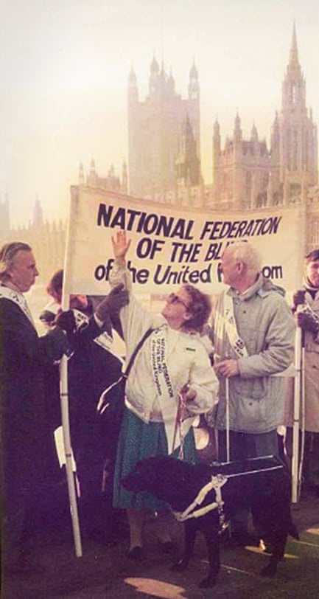
UK Disability History
A Timeline

Slide 12
The first recorded organisation of disabled people in the UK was formed in 1890 (British Deaf Association).
Since this, the campaigning force of disabled people has increasingly strengthened, whether it be through campaigning on the streets of lobbying in Parliament to make a change to the treatment of disabled people.
1890

Slide 13
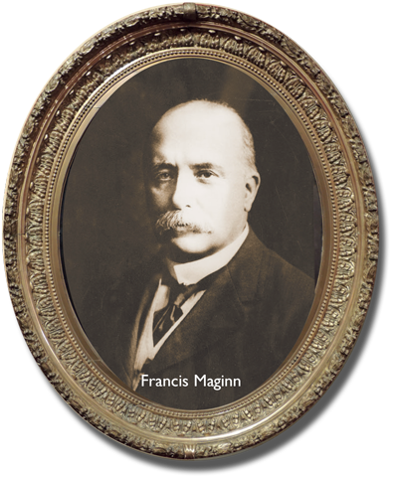
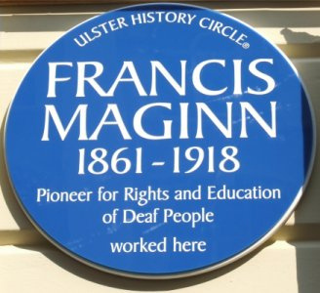

Slide 14
The 1920s saw disabled people on the frontlines protesting, such as the National League of the Blind who held a rally in London in 1920 demanding better working conditions and pay.
People from all over the UK came to the rally and set the precedent for protests throughout the 1920s and 1930s. The most famous of these protests was the Jarrow March.
1920s

Slide 15
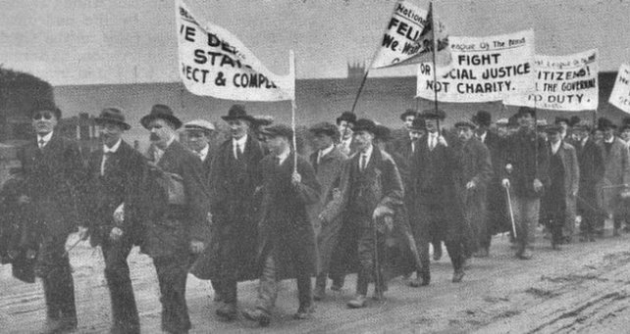

Slide 16
In the 1960s, the Disablement Income Group campaigned for an adequate income for disabled people unable to work.
During the 60’s, employment opportunities for disabled people were limited. Discrimination was rampant and society was simply inaccessible for many disabled people, particularly those who required ramps or lifts.
1960s

Slide 17
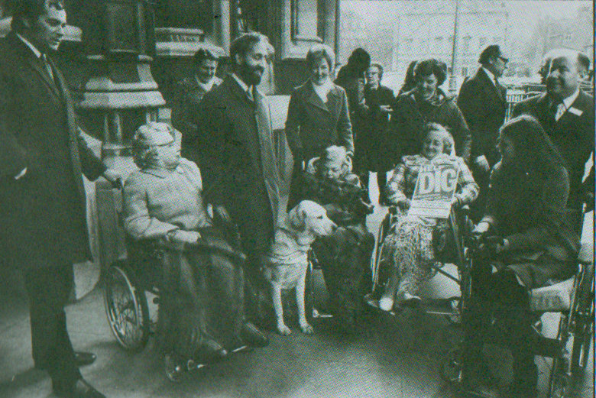

Slide 18
In the 1970s, the Disabled Drivers’ Association campaigned for disabled people to have better support with mobility.
The Association was formed in 1948 and exists today as ‘Mobilise’. Due to the inaccessibility of many buses and trains, many disabled people who required adjustments for access had very few choices for transport. For many, they had to use an ‘Invalid Tricycle Car’.
1970s

Slide 20
In 1973, The Union of the Physically Impaired Against Segregation was formed.
A major breakthrough in disability rights was the UPIAS’ identification of the barriers disabled people face as being the reasons for people being disabled, rather than the medical condition or impairment a person has. This formed the ethos of the Disabled People’s Movement which campaigned for the removal of barriers to disabled people and greater inclusion within society.
1970s

Slide 21
In 1981, the United Nations marked the year as the Year of Disabled People, which gave disabled people greater opportunity and funding to set up groups and organisations of disabled people advocating for their rights.
The 1980s also saw the rise in the campaign for Anti-Discrimination legislation, which later led to the 1995 Disability Discrimination Act 15 years of campaigning and protesting later.
1980s

Slide 23
During the 1980s groups and organisations of disabled people also started pointing out that there should be “nothing about us without us”.
Disabled people also campaigned in support of other oppressed groups of people, such as against Apartheid.
1980s

Slide 25
Activity by disabled people to campaign for inclusion in society reached a high point in the 1990s. This was built on the foundation of disabled people in the 1970s establishing a focus on barriers in society (“disability”) rather than on a disabled person’s medical condition (“impairment”). The building-blocks on top of this were the formation of many groups of disabled people, both nationally and internationally, in the 1980s.
1990s

Slide 26
The 1990s saw the successful protest against “Telethon” – a television show that raised money for charity.
Disabled people felt that the language used and images shown were demeaning, and portrayed disabled people as objects of pity.
1990s

Slide 27
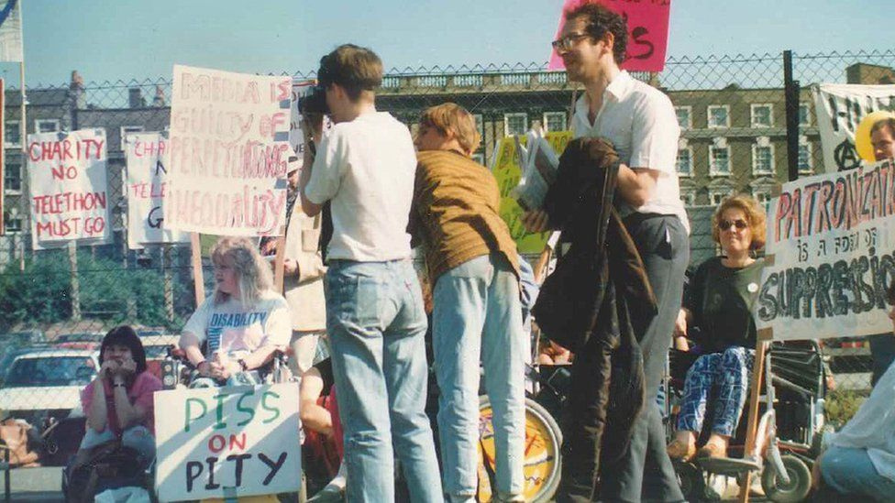

Slide 28
One of the longest and strongest campaigns by disabled people has been to gain accessible public transport.
To do this, disabled people chained themselves to buses and trains, blocked roads, held up traffic and tried to get the politicians and general public to understand that disabled people want the right to travel the same way as non-disabled people.
1990s

Slide 29
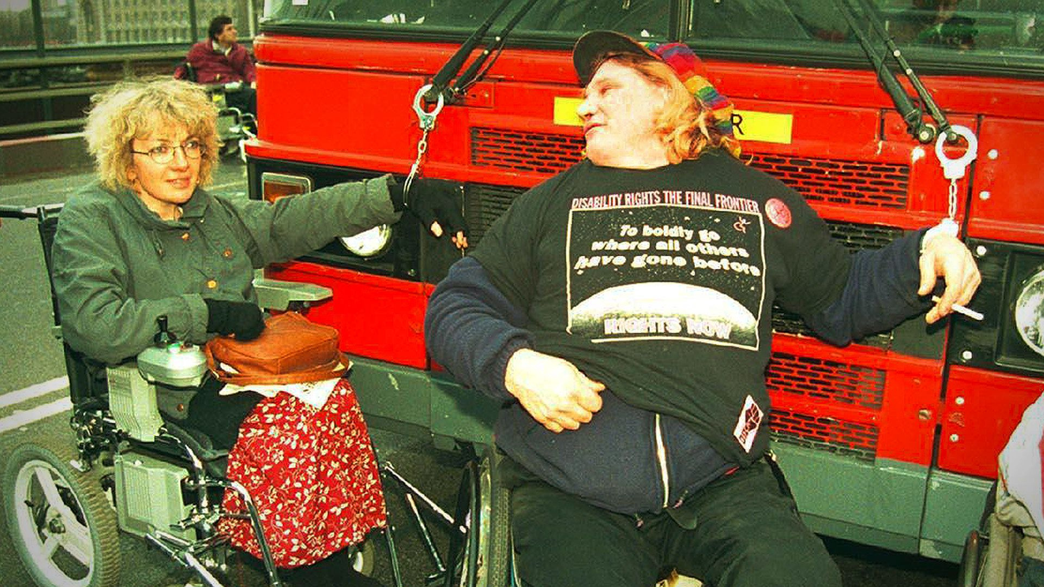

Slide 30
The 1990s and 2000s saw the flourishing of disability art.
Both as a means of highlighting disabled people’s exclusion from society and the discrimination disabled people face, and to “celebrate the difference” of disabled people, and the richness this difference brings to the world
1990s

Slide 31
Deaf people have fought for many years for BSL, (British Sign Language), to be recognised as an official language in its own right.
The campaign was successful on 17 March 2003 when it was agreed by Parliament that BSL could be recognised as an official language.
2000s

Slide 32
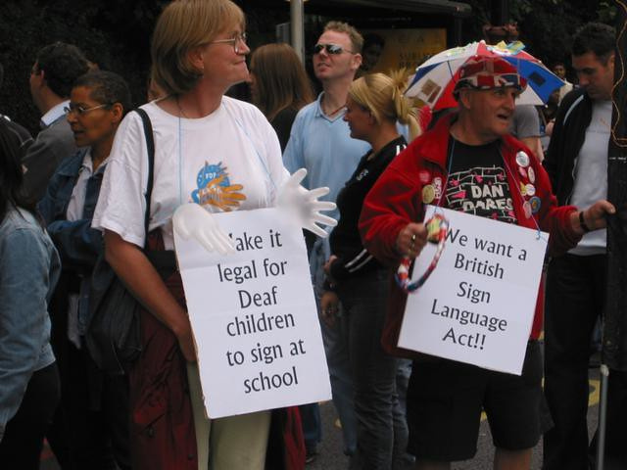

Slide 33
The Millennium brought little change to the need for campaigning by disabled people.
Disabled people and rights groups have continued to campaign for the right to live with dignity, financial support, and against cuts to services and benefits, as well as against bigotry and ablism.
2000s

Slide 34
How can you get involved?

Slide 35
Share the word about Disability History Month and International Day of People with Disabilities
We want to ensure Disability History Month is on everyone’s agenda and communicating about the month is a great way to ensure this. We have put together two teams backgrounds and a email banner to go in your email signature so that Disability History Month is visible to all. Download them from the resource booklet.

Slide 37
Engage with and support forums, groups and self-advocates
The North Yorkshire Disability Forum (NYDF) is a user-led forum that aims to improve the lives of people with physical and/or sensory impairment in North Yorkshire. It is supported by the council to provide a collective voice for disabled people to inform the strategy and service development of NYCC and other statutory bodies to raise awareness of accessibility for disabled people, and to improve access across North Yorkshire.
Find out more here: https://www.nypartnerships.org.uk/nydf or contact claire.canavan@northyorks.gov.uk

Slide 38
North Yorkshire Learning Disability Partnership Board promotes the independence, rights, choice and inclusion of people with a learning disability, autistic people, families and carers across North Yorkshire. Meetings are co-chaired by a self-advocate with a learning disability and/or autism and a community member.
Find out more here Learning Disability Partnership Board | North Yorkshire Partnerships (nypartnerships.org.uk) or contact claire.canavan@northyorks.gov.uk

Slide 39
Harrogate Mental Health Service User and Carer Involvement Group is supported by North Yorkshire County Council and Tees Esk and Wear Valley NHS Foundation Trust. It brings together mental health service users, carers and people who work in mental health to improve services. Contact Wendy.Clark@northyorks.gov.uk for more information.
York Disability Rights Forum is led by disabled people and works to promote equal access to human rights for all those with disabilities who live or work in York. The Forum aims to be a collective voice, to raise awareness of issues affecting disabled people in York and create positive changes.
Find out more here: https://ydrf.org.uk/

Slide 40
References
Scope - https://www.scope.org.uk/media/disability-facts-figures/
InclusionLondon - https://www.inclusionlondon.org.uk/disability-in-london/social-model/the-social-model-of-disability-and-the-cultural-model-of-deafness/
The Guardian - https://www.theguardian.com/society/2015/nov/04/disabled-people-fight-equal-rights-exhibition-manchester
Historic England - A (historicengland.org.uk)

