Slide 1
North Yorkshire Safeguarding Adults Board (NYSAB)
Quarter 4 Update

Slide 2
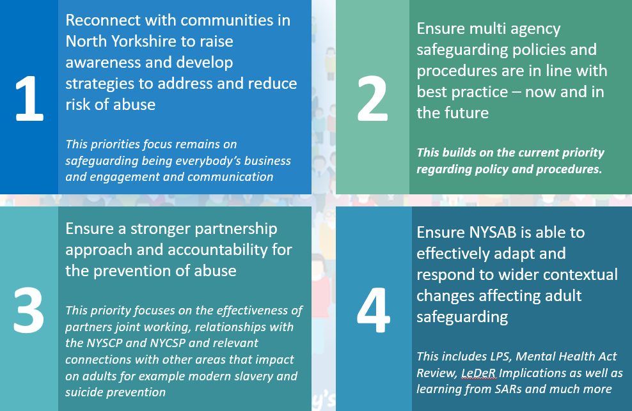
www.safeguardingadults.co.uk
www.safeguardingadults.co.uk
Follow us on Twitter: @NYSAB1
Follow us on Twitter: @NYSAB1
NYSAB Strategic Priorities 2021 – 23 Overview
NYSAB Strategic Priorities for 2020-2023

Slide 3
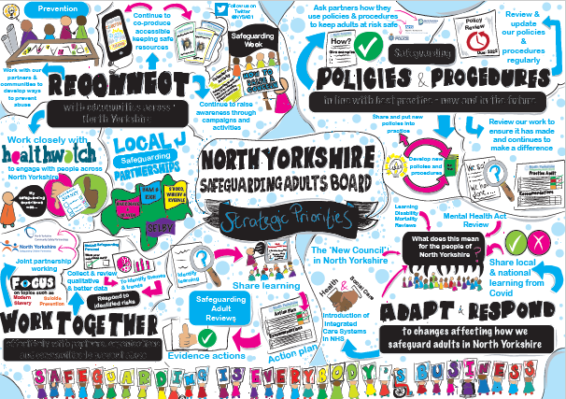
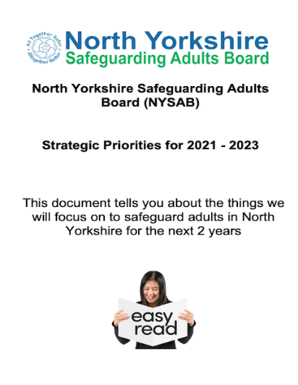
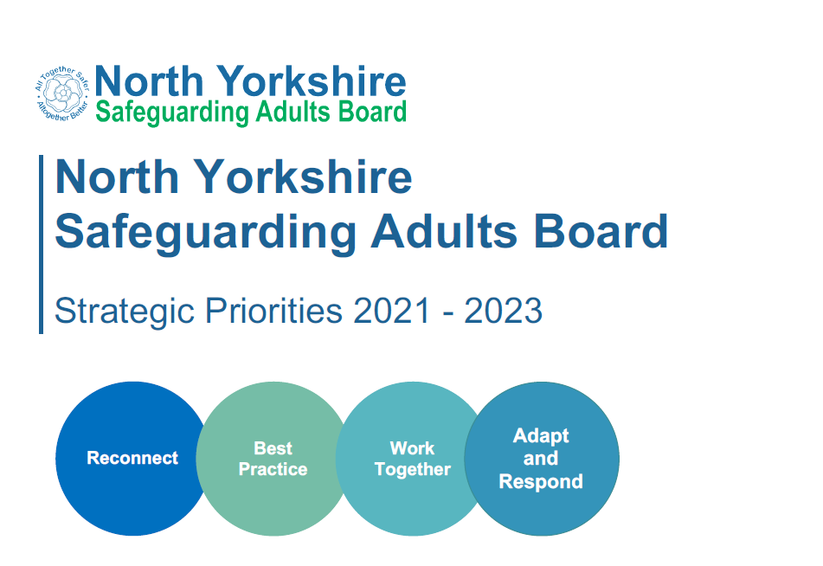
www.safeguardingadults.co.uk
www.safeguardingadults.co.uk
Follow us on Twitter: @NYSAB1
Follow us on Twitter: @NYSAB1
In our commitment to be a fully accessible and inclusive safeguarding adults board, we have produced the following versions of our strategic priorities.
We hope that by having accessible documents, people who live, work and volunteer in North Yorkshire will not only have a clearer understanding as to what the Board wants to achieve, but what these priorities mean for them.
To view and download the versions below, and also access an audio version visit: https://safeguardingadults.co.uk/strategic-priorities
Please share these throughout your organisations, networks and communities
NYSAB Strategic Priorities 2021 – 23 Resources
NYSAB Strategic Priorities for 2020-2023
Notes:
Accessible versions of the priorities include:
- Public facing
- Easy read version

Slide 4
www.safeguardingadults.co.uk
Follow us on Twitter: @NYSAB1
The NYSAB Development Day took place on Monday 29th November.
The session focused upon the learning identified during the COVID pandemic in relation to keeping people safe. Particular attention was given to three areas where additional inequalities have been experienced during the pandemic; homelessness, domestic abuse, mental health and learning disability.
Overall feedback from attendees for consideration by the Board:
We should reinforce the idea that keeping people safe during a pandemic is everyone’s business. This will be set out in the Annual Report and further communications.
Homelessness will be a recurring theme in 2022 for the NYSAB, and there will be a dedicated session in February.
What dialogue is to be had with Board members, ICS Board Members, and the Office of Police, Fire, & Crime Commissioner to increase engagement with the work of the Board.
The SAB needs to seek assurance from partners that they are supporting the wellbeing of staff.
Sharing learning in an open manner should be part and parcel of how the SAB does business.
NYSAB Development Day 2021
Notes:
Following the development day - at its quarterly meeting in December, the Board agreed that the Executive group would review the NYSAB delivery plan to ensure it aligns with the feedback and recommendations from the development day.

Slide 5
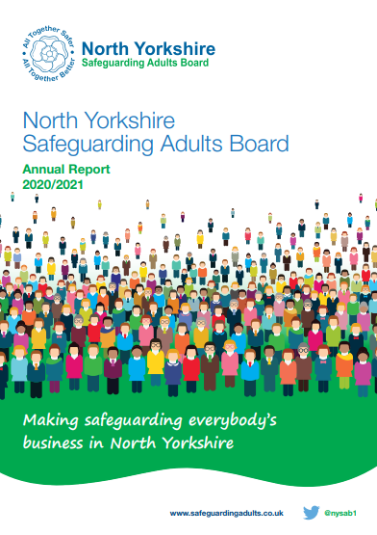
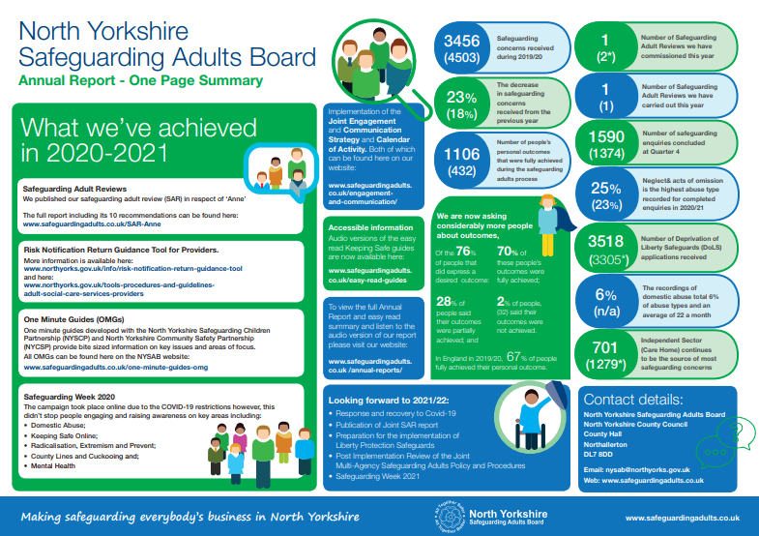
www.safeguardingadults.co.uk
Follow us on Twitter: @NYSAB1
We published our Annual Report on the 18th October and unsurprisingly it captures the work that has been undertaken by the Board and its partners across North Yorkshire in response to Covid and particularly the fantastic work that has been carried out by organisations, volunteers and communities to safeguard adults at risk across North Yorkshire throughout the pandemic.
We have also highlighted the other work that has been carried out throughout the year and that which has been achieved by the Board during 2020-21
To view and download the versions shown below as well as an audio version, visit https://safeguardingadults.co.uk/annual-reports
Again, please share throughout your networks, organisations and communities.
NYSAB Annual Report
Easy read summary
Full report
One page visual summary

Slide 6
www.safeguardingadults.co.uk
Follow us on Twitter: @NYSAB1
Audit of the learning from previous SARs
Following thematic analysis of the SARs published by the NYSAB between 2012 and 2021, the learning and review sub-group has been tasked with auditing learning identified within these reviews to ensure changes in practice have been embedded, and long-term change has been sustained by relevant agencies.
A task and finish group, which is managed through the policies, practice development and legislation (PPDL) sub-group, identified a preferred multi-agency audit tool and work is now underway to finalise the tool.
The themes that were identified through the SAR thematic analysis
have been transposed into the audit tool.
A recommendation will be made to the PPDL sub-group in January
that an audit is completed every 2 months (subject to review).
The LAR will be required to monitor the audits to ensure learning
is being evidenced within the audits.
Audit of learning from previous SARs

Slide 7
www.safeguardingadults.co.uk
Follow us on Twitter: @NYSAB1
One Minute Guides – https://safeguardingadults.co.uk/working-with-adults/one-minute-guides-omg/
Keeping Safe Resources - https://safeguardingadults.co.uk/keeping-safe/easy-read-guides/
Training - https://safeguardingadults.co.uk/learning-research/training-courses/
NYSAB Procedures - https://safeguardingadults.co.uk/working-with-adults/nysab-procedures/
Resources
& Keeping up to date with the NYSAB
Twitter
Newsletter
Website
www.safeguardingadults.co.uk/nysab-newsletter
www.safeguardingadults.co.uk
www.twitter.com/nysab1

Slide 9
Community Safety Partnerships are under a statutory duty to work together to:
Reduce reoffending
Tackle crime and disorder
Tackle anti-social behaviour
Undertake Domestic Homicide Reviews
Areas for Delivery and Development (2018-22)
NYCSP has agreed the following priority areas for delivery
Partnership development
Community Safety Hubs
Domestic Abuse (including scoping Sexual Violence and Trauma)
Serious and Organised Crime (early intervention and prevention)
Hate Crime and Community Cohesion

Slide 10
Domestic Abuse update
The Domestic Abuse Act 2021 introduced 7 parts of legislative change that will positively impact on victims, survivors and their children and transforming the response to domestic abuse.
Part 4 of this legislation now introduces a new ‘Safe
Accommodation Duty’ on tier 1 authorities (NYCC&CYC)
Final North Yorkshire County Council & City of York Council Domestic Abuse Safe Accommodation Strategy 2021-2024 is drafted and awaiting publication on 5th January 2022

Slide 11
Our Strategy Our Principles
Authentic voice of victims/ survivors and their children to inform our partnership approaches.
Effective pathways- supporting those with ‘additional needs’
It’s not Safe Accommodation if support is not in place. It is not just bricks and mortar.
Clear, consistent approaches must be in place across York and North Yorkshire.
Meeting the needs of individuals, families and communities.
Understanding our need and demand for safe accommodation.
Ensuring we have effective partnership arrangements (Domestic Abuse Local Partnership Board).

Slide 12
Continued..
The national Victims’ Bill consultation has now been launched, and will run for a period of 8 weeks until the 3rd February 2022.
Delivering justice for victims: A consultation on improving victims’ experiences of the justice system - Ministry of Justice - Citizen Space
This consultation will consider how we can make concrete improvements to victims’ experience of and confidence in the criminal justice system, and their support. The resulting legislation will be the cornerstone of our work across government to ensure that victims’ needs lie at the heart of the criminal justice system

Slide 13
York and North Yorkshire Road Safety Partnership Safer Roads Strategy 2021 -26
The Safer Roads Strategy 2021-2026 aim to:
Improve the quality of life in North Yorkshire by reducing the economic and social impact of road collisions.
Meet the road safety objectives set by the DfT by changing attitudes and behaviour.
Increase the public’s awareness of road safety issues in North Yorkshire.
Work with parents to develop a co-ordinated road safety approach – bringing together the three components of:
education, training and publicity
traffic engineering
Enforcement
About us – Roadwise or email 95alive@northyorks.gov.uk

Slide 14
Hate Crime and Community Cohesion
Inclusive Communities Joint Coordinating Group is hosting a development session on the 12th January 22 to reflect on the achievements over the past 12 months and to set priorities for forthcoming 12 months.
Training
2nd & 3rd February 22: Media Literacy and Extremism ‘train the trainer’ session for key professionals who work directly with vulnerable young people and adults.
28th February 22: Medial Literacy and Extremism Workshop for Young People supported by North Yorkshire Youth Commission and North Yorkshire Youth
Community Tensions ‘round table’ event 9th March 2022 with key partners from City of York and North Yorkshire

Slide 15
Prevent
Prevent Training Offer has been developed for partners offering a calendar of training for the next 12 months.
Includes awareness session on Hate Crime, Community Tension and Prevent awareness sessions, linking to the Prevent Competency Framework for North Yorkshire.
www.nypartnership.org
Prevent Awareness Training Friday 21st January 11:00- 12:00
https://www.eventbrite.co.uk/e/prevent-awareness-tickets-221317956967
Recommendations from the Independent Review of the Prevent Strategy is expected by the end of December 2021

Slide 16
Contact
Lesley Gray, Principal Safer Communities Officer, NYCC
Lesley.gray@northyorks.gov.uk

Slide 17
North Yorkshire Safeguarding Children Partnership
Q4 2021/2022 Update

Slide 18
Be Aware
The “Be Aware” element of the NYSCP website is being developed
Pages for children, young people, parents and carers will be introduced to deliver key messages on contextual safeguarding and extra familial harm
Key messages that the site will include will be messages of safety, as well as recognising warning signs of possible exploitation and how to access support
The site is scheduled to go live in spring 2022
Notes:
Following the successful launch of our professionals online knowledge hub, Be Aware; designed to prevent and tackle exploitation (www.safeguardingchildren.co.uk/beaware) in March 2021, work has now started on the production of additional pages will be developed and specifically designed for young people and parents/carers to deliver key massages relating to contextual safeguarding and extra familial harm.
The project is being completed in collaboration with young people and parents/carers from our county; so they have a chance to share their stories and ensure the messages and resources shared on the site are the one that will make the biggest impact for families in North Yorkshire For example:
Trusted relationship project
Children and families service.
Police, fire and crime youth commission
PACE
Community youth groups
Key messages that the site will include will be messages of safety, as well as recognising warning signs of possible exploitation and how to access support.
The site is due to go live in late spring 2022 with a launch and communications package that will be shared with partners.
If any partners would like to know more about the project or have any links to any groups of young people or parents/carers who they feel would like to get involved – please contact Kathryn.morrison@northyorks.gov.uk

Slide 19
Annual Reports
For more information visit www.safeguardingchildren.co.uk
Notes:
It is annual report time and the new NYSCP Scrutineer Annual Report has been produced and the Child Death Overview Panel Annual Report
For more information visit our website

Slide 20
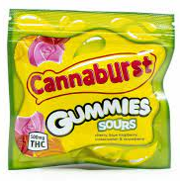
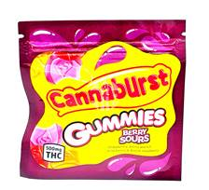
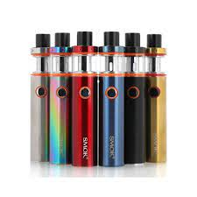
Edibles
Following a recent seizure of Cannabis and Edibles by North Yorkshire Police, partners are reminded to submit any information that they are hearing from young people or through intelligence derived from local communities through the Police partnership information sharing form
www.safeguardingchildren.co.uk.
Vapes
There is increasing concerns being reported by schools about the use of vapes amongst young people. This includes buying and selling vapes, but also concerns about what is being put in them. We have had reports in various MACE locality meetings around the usage of THC (psychoactive substance in cannabis) and possibly ‘spice’. This is being monitored through the Emerging Drugs Trends Group for North Yorkshire
and City of York.
Benzodiazepines and Cannabis
Young people are increasingly telling us that they are using Benzodiazepines (including Valium, Xanax and Diazepam), they are able to buy these tables for a few pounds in their local areas. We are also concerned at the numbers of young people using cannabis and indeed incidences of their bringing it into school. Some young people are reporting that they are using it to self medicate for mental health issues. However we are aware cannabis debt bondage is the most common route in North Yorkshire for children to be exploited, so we have concerns about the frequency and availability of this. This is being picked up through the Emerging Drug Trends and MACE Operational Groups.
Ongoing Work Streams
MACE Data Set A working group of key professionals has been set up to look at our current data set around MACE, what data partners hold and what we need to know as a partnership to facilitate our response to child exploitation
Language around Exploitation A working group has been set up to look at creating resources to ensure that as a partnership professionals are equipped to ensure they us appropriate terminology when referring to children at risk of or experiencing child exploitation and their families.
Online Platforms of Concern
Over the past quarter a number of social media platforms have been raised including:
Yubo – formally known as ‘Yellow’, a joint app with snapchat and used as an online dating app for young people under 18 – known as ’Tinder for Teens’
Saharah - app that has been used for cyber bulling and potential grooming – anonymous and encrypted.
Cunch Line Chronicles – Online County Lines Game – Explored by the Regional Organised Crime Unit, no clear links of trying to recruit children as yet, but promotes the running of county lines
MACE at a Glance
63 Children assessed as at Risk of Child Exploitation
15 High Risk (12 of which are CCE)
20 Medium Risk
32 Low Risk **some children have dual case status
Slight more boys at risk than girls
Increasingly seeing children age 10 – 13 identified as at risk of exploitation
Increase in perpetrators identified following proactive work with NYP
Most common type of exploitation is adults exploitation children to run drugs in NY
Notes:
partners are reminded to submit any information that they are hearing through the Police partnership information sharing form
There is increasing concerns being reported by schools about the use of vapes amongst young people. This includes buying and selling vapes, but also concerns about the usage of THC (psychoactive substance in cannabis) and possibly ‘spice’.
Young people are increasingly using Benzodiazepines (including Valium, Xanax and Diazepam), they are able to buy these for few pounds in their local areas. We are also concerned at the numbers of young people using cannabis and indeed incidences of their bringing it into school. Some young people are reporting self medicate for mental health issues. However we are aware cannabis debt bondage is the most common route in North Yorkshire for children to be exploited,
A working group of key professionals has been set up to look at our current data set around MACE
A working group has been set up to look at creating resources to ensure that as a partnership professionals are equipped to ensure they us appropriate terminology
Over the past quarter a number of social media platforms have been raised including:
Yubo, Saharah and Cunch Line Chronicles

Slide 21
Edibles
Following a recent seizure of Cannabis and Edibles by North Yorkshire Police, partners are reminded to submit any information that they are hearing from young people or through intelligence derived from local communities through the Police partnership information sharing form
www.safeguardingchildren.co.uk.
Vapes
There is increasing concerns being reported by schools about the use of vapes amongst young people. This includes buying and selling vapes, but also concerns about what is being put in them. We have had reports in various MACE locality meetings around the usage of THC (psychoactive substance in cannabis) and possibly ‘spice’. This is being monitored through the Emerging Drugs Trends Group for North Yorkshire
and City of York.
Benzodiazepines and Cannabis
Young people are increasingly telling us that they are using Benzodiazepines (including Valium, Xanax and Diazepam), they are able to buy these tables for a few pounds in their local areas. We are also concerned at the numbers of young people using cannabis and indeed incidences of their bringing it into school. Some young people are reporting that they are using it to self medicate for mental health issues. However we are aware cannabis debt bondage is the most common route in North Yorkshire for children to be exploited, so we have concerns about the frequency and availability of this. This is being picked up through the Emerging Drug Trends and MACE Operational Groups.
Ongoing Work Streams
MACE Data Set A working group of key professionals has been set up to look at our current data set around MACE, what data partners hold and what we need to know as a partnership to facilitate our response to child exploitation
Language around Exploitation A working group has been set up to look at creating resources to ensure that as a partnership professionals are equipped to ensure they us appropriate terminology when referring to children at risk of or experiencing child exploitation and their families.
Online Platforms of Concern
Over the past quarter a number of social media platforms have been raised including:
Yubo – formally known as ‘Yellow’, a joint app with snapchat and used as an online dating app for young people under 18 – known as ’Tinder for Teens’
Saharah - app that has been used for cyber bulling and potential grooming – anonymous and encrypted.
Cunch Line Chronicles – Online County Lines Game – Explored by the Regional Organised Crime Unit, no clear links of trying to recruit children as yet, but promotes the running of county lines
MACE at a Glance
63 Children assessed as at Risk of Child Exploitation
15 High Risk (12 of which are CCE)
20 Medium Risk
32 Low Risk **some children have dual case status
Slight more boys at risk than girls
Increasingly seeing children age 10 – 13 identified as at risk of exploitation
Increase in perpetrators identified following proactive work with NYP
Most common type of exploitation is adults exploitation children to run drugs in NY
Notes:
partners are reminded to submit any information that they are hearing through the Police partnership information sharing form
There is increasing concerns being reported by schools about the use of vapes amongst young people. This includes buying and selling vapes, but also concerns about the usage of THC (psychoactive substance in cannabis) and possibly ‘spice’.
Young people are increasingly using Benzodiazepines (including Valium, Xanax and Diazepam), they are able to buy these for few pounds in their local areas. We are also concerned at the numbers of young people using cannabis and indeed incidences of their bringing it into school. Some young people are reporting self medicate for mental health issues. However we are aware cannabis debt bondage is the most common route in North Yorkshire for children to be exploited,
A working group of key professionals has been set up to look at our current data set around MACE
A working group has been set up to look at creating resources to ensure that as a partnership professionals are equipped to ensure they us appropriate terminology
Over the past quarter a number of social media platforms have been raised including:
Yubo, Saharah and Cunch Line Chronicles

Slide 22
Edibles
Following a recent seizure of Cannabis and Edibles by North Yorkshire Police, partners are reminded to submit any information that they are hearing from young people or through intelligence derived from local communities through the Police partnership information sharing form
www.safeguardingchildren.co.uk.
Vapes
There is increasing concerns being reported by schools about the use of vapes amongst young people. This includes buying and selling vapes, but also concerns about what is being put in them. We have had reports in various MACE locality meetings around the usage of THC (psychoactive substance in cannabis) and possibly ‘spice’. This is being monitored through the Emerging Drugs Trends Group for North Yorkshire
and City of York.
Benzodiazepines and Cannabis
Young people are increasingly telling us that they are using Benzodiazepines (including Valium, Xanax and Diazepam), they are able to buy these tables for a few pounds in their local areas. We are also concerned at the numbers of young people using cannabis and indeed incidences of their bringing it into school. Some young people are reporting that they are using it to self medicate for mental health issues. However we are aware cannabis debt bondage is the most common route in North Yorkshire for children to be exploited, so we have concerns about the frequency and availability of this. This is being picked up through the Emerging Drug Trends and MACE Operational Groups.
Ongoing Work Streams
MACE Data Set A working group of key professionals has been set up to look at our current data set around MACE, what data partners hold and what we need to know as a partnership to facilitate our response to child exploitation
Language around Exploitation A working group has been set up to look at creating resources to ensure that as a partnership professionals are equipped to ensure they us appropriate terminology when referring to children at risk of or experiencing child exploitation and their families.
Online Platforms of Concern
Over the past quarter a number of social media platforms have been raised including:
Yubo – formally known as ‘Yellow’, a joint app with snapchat and used as an online dating app for young people under 18 – known as ’Tinder for Teens’
Saharah - app that has been used for cyber bulling and potential grooming – anonymous and encrypted.
Cunch Line Chronicles – Online County Lines Game – Explored by the Regional Organised Crime Unit, no clear links of trying to recruit children as yet, but promotes the running of county lines
MACE at a Glance
63 Children assessed as at Risk of Child Exploitation
15 High Risk (12 of which are CCE)
20 Medium Risk
32 Low Risk **some children have dual case status
Slight more boys at risk than girls
Increasingly seeing children age 10 – 13 identified as at risk of exploitation
Increase in perpetrators identified following proactive work with NYP
Most common type of exploitation is adults exploitation children to run drugs in NY
Notes:
partners are reminded to submit any information that they are hearing through the Police partnership information sharing form
There is increasing concerns being reported by schools about the use of vapes amongst young people. This includes buying and selling vapes, but also concerns about the usage of THC (psychoactive substance in cannabis) and possibly ‘spice’.
Young people are increasingly using Benzodiazepines (including Valium, Xanax and Diazepam), they are able to buy these for few pounds in their local areas. We are also concerned at the numbers of young people using cannabis and indeed incidences of their bringing it into school. Some young people are reporting self medicate for mental health issues. However we are aware cannabis debt bondage is the most common route in North Yorkshire for children to be exploited,
A working group of key professionals has been set up to look at our current data set around MACE
A working group has been set up to look at creating resources to ensure that as a partnership professionals are equipped to ensure they us appropriate terminology
Over the past quarter a number of social media platforms have been raised including:
Yubo, Saharah and Cunch Line Chronicles

Slide 23
Edibles
Following a recent seizure of Cannabis and Edibles by North Yorkshire Police, partners are reminded to submit any information that they are hearing from young people or through intelligence derived from local communities through the Police partnership information sharing form
www.safeguardingchildren.co.uk.
Vapes
There is increasing concerns being reported by schools about the use of vapes amongst young people. This includes buying and selling vapes, but also concerns about what is being put in them. We have had reports in various MACE locality meetings around the usage of THC (psychoactive substance in cannabis) and possibly ‘spice’. This is being monitored through the Emerging Drugs Trends Group for North Yorkshire
and City of York.
Benzodiazepines and Cannabis
Young people are increasingly telling us that they are using Benzodiazepines (including Valium, Xanax and Diazepam), they are able to buy these tables for a few pounds in their local areas. We are also concerned at the numbers of young people using cannabis and indeed incidences of their bringing it into school. Some young people are reporting that they are using it to self medicate for mental health issues. However we are aware cannabis debt bondage is the most common route in North Yorkshire for children to be exploited, so we have concerns about the frequency and availability of this. This is being picked up through the Emerging Drug Trends and MACE Operational Groups.
Ongoing Work Streams
MACE Data Set A working group of key professionals has been set up to look at our current data set around MACE, what data partners hold and what we need to know as a partnership to facilitate our response to child exploitation
Language around Exploitation A working group has been set up to look at creating resources to ensure that as a partnership professionals are equipped to ensure they us appropriate terminology when referring to children at risk of or experiencing child exploitation and their families.
Online Platforms of Concern
Over the past quarter a number of social media platforms have been raised including:
Yubo – formally known as ‘Yellow’, a joint app with snapchat and used as an online dating app for young people under 18 – known as ’Tinder for Teens’
Saharah - app that has been used for cyber bulling and potential grooming – anonymous and encrypted.
Cunch Line Chronicles – Online County Lines Game – Explored by the Regional Organised Crime Unit, no clear links of trying to recruit children as yet, but promotes the running of county lines
MACE at a Glance
63 Children assessed as at Risk of Child Exploitation
15 High Risk (12 of which are CCE)
20 Medium Risk
32 Low Risk **some children have dual case status
Slight more boys at risk than girls
Increasingly seeing children age 10 – 13 identified as at risk of exploitation
Increase in perpetrators identified following proactive work with NYP
Most common type of exploitation is adults exploitation children to run drugs in NY
Notes:
partners are reminded to submit any information that they are hearing through the Police partnership information sharing form
There is increasing concerns being reported by schools about the use of vapes amongst young people. This includes buying and selling vapes, but also concerns about the usage of THC (psychoactive substance in cannabis) and possibly ‘spice’.
Young people are increasingly using Benzodiazepines (including Valium, Xanax and Diazepam), they are able to buy these for few pounds in their local areas. We are also concerned at the numbers of young people using cannabis and indeed incidences of their bringing it into school. Some young people are reporting self medicate for mental health issues. However we are aware cannabis debt bondage is the most common route in North Yorkshire for children to be exploited,
A working group of key professionals has been set up to look at our current data set around MACE
A working group has been set up to look at creating resources to ensure that as a partnership professionals are equipped to ensure they us appropriate terminology
Over the past quarter a number of social media platforms have been raised including:
Yubo, Saharah and Cunch Line Chronicles

Slide 24
Edibles
Following a recent seizure of Cannabis and Edibles by North Yorkshire Police, partners are reminded to submit any information that they are hearing from young people or through intelligence derived from local communities through the Police partnership information sharing form
www.safeguardingchildren.co.uk.
Vapes
There is increasing concerns being reported by schools about the use of vapes amongst young people. This includes buying and selling vapes, but also concerns about what is being put in them. We have had reports in various MACE locality meetings around the usage of THC (psychoactive substance in cannabis) and possibly ‘spice’. This is being monitored through the Emerging Drugs Trends Group for North Yorkshire
and City of York.
Benzodiazepines and Cannabis
Young people are increasingly telling us that they are using Benzodiazepines (including Valium, Xanax and Diazepam), they are able to buy these tables for a few pounds in their local areas. We are also concerned at the numbers of young people using cannabis and indeed incidences of their bringing it into school. Some young people are reporting that they are using it to self medicate for mental health issues. However we are aware cannabis debt bondage is the most common route in North Yorkshire for children to be exploited, so we have concerns about the frequency and availability of this. This is being picked up through the Emerging Drug Trends and MACE Operational Groups.
Ongoing Work Streams
MACE Data Set A working group of key professionals has been set up to look at our current data set around MACE, what data partners hold and what we need to know as a partnership to facilitate our response to child exploitation
Language around Exploitation A working group has been set up to look at creating resources to ensure that as a partnership professionals are equipped to ensure they us appropriate terminology when referring to children at risk of or experiencing child exploitation and their families.
Online Platforms of Concern
Over the past quarter a number of social media platforms have been raised including:
Yubo – formally known as ‘Yellow’, a joint app with snapchat and used as an online dating app for young people under 18 – known as ’Tinder for Teens’
Saharah - app that has been used for cyber bulling and potential grooming – anonymous and encrypted.
Cunch Line Chronicles – Online County Lines Game – Explored by the Regional Organised Crime Unit, no clear links of trying to recruit children as yet, but promotes the running of county lines
MACE at a Glance
63 Children assessed as at Risk of Child Exploitation
15 High Risk (12 of which are CCE)
20 Medium Risk
32 Low Risk **some children have dual case status
Slight more boys at risk than girls
Increasingly seeing children age 10 – 13 identified as at risk of exploitation
Increase in perpetrators identified following proactive work with NYP
Most common type of exploitation is adults exploitation children to run drugs in NY
Notes:
partners are reminded to submit any information that they are hearing through the Police partnership information sharing form
There is increasing concerns being reported by schools about the use of vapes amongst young people. This includes buying and selling vapes, but also concerns about the usage of THC (psychoactive substance in cannabis) and possibly ‘spice’.
Young people are increasingly using Benzodiazepines (including Valium, Xanax and Diazepam), they are able to buy these for few pounds in their local areas. We are also concerned at the numbers of young people using cannabis and indeed incidences of their bringing it into school. Some young people are reporting self medicate for mental health issues. However we are aware cannabis debt bondage is the most common route in North Yorkshire for children to be exploited,
A working group of key professionals has been set up to look at our current data set around MACE
A working group has been set up to look at creating resources to ensure that as a partnership professionals are equipped to ensure they us appropriate terminology
Over the past quarter a number of social media platforms have been raised including:
Yubo, Saharah and Cunch Line Chronicles

Slide 25
Edibles
Following a recent seizure of Cannabis and Edibles by North Yorkshire Police, partners are reminded to submit any information that they are hearing from young people or through intelligence derived from local communities through the Police partnership information sharing form
www.safeguardingchildren.co.uk.
Vapes
There is increasing concerns being reported by schools about the use of vapes amongst young people. This includes buying and selling vapes, but also concerns about what is being put in them. We have had reports in various MACE locality meetings around the usage of THC (psychoactive substance in cannabis) and possibly ‘spice’. This is being monitored through the Emerging Drugs Trends Group for North Yorkshire
and City of York.
Benzodiazepines and Cannabis
Young people are increasingly telling us that they are using Benzodiazepines (including Valium, Xanax and Diazepam), they are able to buy these tables for a few pounds in their local areas. We are also concerned at the numbers of young people using cannabis and indeed incidences of their bringing it into school. Some young people are reporting that they are using it to self medicate for mental health issues. However we are aware cannabis debt bondage is the most common route in North Yorkshire for children to be exploited, so we have concerns about the frequency and availability of this. This is being picked up through the Emerging Drug Trends and MACE Operational Groups.
Ongoing Work Streams
MACE Data Set A working group of key professionals has been set up to look at our current data set around MACE, what data partners hold and what we need to know as a partnership to facilitate our response to child exploitation
Language around Exploitation A working group has been set up to look at creating resources to ensure that as a partnership professionals are equipped to ensure they us appropriate terminology when referring to children at risk of or experiencing child exploitation and their families.
Online Platforms of Concern
Over the past quarter a number of social media platforms have been raised including:
Yubo – formally known as ‘Yellow’, a joint app with snapchat and used as an online dating app for young people under 18 – known as ’Tinder for Teens’
Saharah - app that has been used for cyber bulling and potential grooming – anonymous and encrypted.
Cunch Line Chronicles – Online County Lines Game – Explored by the Regional Organised Crime Unit, no clear links of trying to recruit children as yet, but promotes the running of county lines
MACE at a Glance
63 Children assessed as at Risk of Child Exploitation
15 High Risk (12 of which are CCE)
20 Medium Risk
32 Low Risk **some children have dual case status
Slight more boys at risk than girls
Increasingly seeing children age 10 – 13 identified as at risk of exploitation
Increase in perpetrators identified following proactive work with NYP
Most common type of exploitation is adults exploitation children to run drugs in NY
Notes:
partners are reminded to submit any information that they are hearing through the Police partnership information sharing form
There is increasing concerns being reported by schools about the use of vapes amongst young people. This includes buying and selling vapes, but also concerns about the usage of THC (psychoactive substance in cannabis) and possibly ‘spice’.
Young people are increasingly using Benzodiazepines (including Valium, Xanax and Diazepam), they are able to buy these for few pounds in their local areas. We are also concerned at the numbers of young people using cannabis and indeed incidences of their bringing it into school. Some young people are reporting self medicate for mental health issues. However we are aware cannabis debt bondage is the most common route in North Yorkshire for children to be exploited,
A working group of key professionals has been set up to look at our current data set around MACE
A working group has been set up to look at creating resources to ensure that as a partnership professionals are equipped to ensure they us appropriate terminology
Over the past quarter a number of social media platforms have been raised including:
Yubo, Saharah and Cunch Line Chronicles

Slide 26
NYSCP Section 11 / Governance Audit
High level of compliance with the criteria outlined in the audit across partners working with both children and adults
Impact of COVID:
Increase in demand for services
Reviews of pathways, systems and processes
Technological solutions
Partners recognise that COVID has had both positive and negative impacts:
Partner organisations aware of impact of the wellbeing of staff, particularly new starters
Benefits of virtual working environments
Areas for development by partners included:
Development of key strategies and procedures for domestic abuse and safeguarding
Improvements to the recording of training
Ensuring appropriate mechanisms for raising concerns against staff and managing allegations
Accessibility of information and undertaking of Equality Impact Assessments
Ensuring appropriate supervision arrangements are in place
Information sharing – procedures and training
Examine the possibility of the development of a MASH for Adult Services

Slide 27
Peer on Peer Briefing
Offer of Support to Schools and Colleges in North Yorkshire regarding Peer on Peer Abuse
Although aimed at schools, there is relevant information for all partners, visit:
https://www.safeguardingchildren.co.uk/offer-of-support-to-schools-and-colleges-regarding-peer-on-peer-abuse/
Information includes:
Defining peer on peer abuse
Legislation and national guidance
National support organisation
Local support for schools and colleges
Local organisation and useful contacts
Frequently asked questions (FAQs)

Slide 28
Sudden Unexpected Death in Infancy
The NYSCP is looking to deliver a programme of work that aims to reduce risks of Sudden Unexpected Deaths in Infancy (SUDI)
A new campaign, ‘Day or night, sleep right’, focusing on supporting professionals to help them help parents to understand the risks
For more information visit:
https://www.safeguardingchildren.co.uk/sleepright/
https://www.safeguardingchildren.co.uk/parents-carers/caring-for-your-baby/safer-sleep-for-babies/
https://www.lullabytrust.org.uk/professionals/
See also our SUDI: Prevent and Protect Training
https://www.safeguardingchildren.co.uk/training-north-yorkshire/training-courses

Slide 29
Harmful Sexual Behaviours
Brook Traffic Light Tool – Update concerns
Need to update procedures, practice guidance and training across organisations
Agreed to work with the City of York Safeguarding Children Partnership to share procedures, etc.
Looking to adopt the Hackett Continuum model
New task and finish group established to look at Harmful Sexual Behaviours
Scoping currently underway to understand the multi-agency costs for implementation including training for AIM3
Notes:
Brook tool is copyright, need to update to new version – only accessible through fire wall, too costly to train everyone
Procedures need updating
CYSCP already completed this work and will make easier for partners working across areas

Slide 30
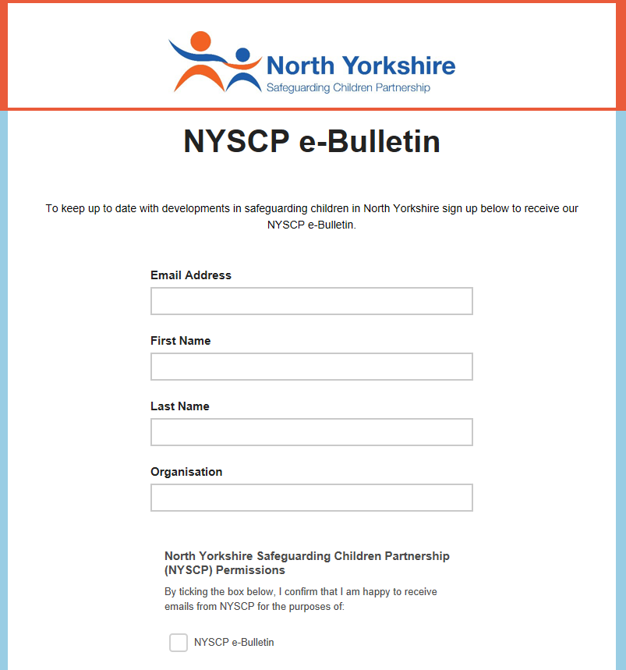
Keep up to date with NYSCP
Free NYSCP Monthly
e-Bulletin Sign Up here
Follow us on twitter @nyscp1
Follow us on Facebook @nyscp1
Notes:
Don’t forget to sign up to our monthly e-bulletin, and follow us on social media via Twitter and Facebook

Slide 31
If you would like more information about the local safeguarding partnerships please see the contact details below for the Chair and Business Support of each LSP
Harrogate and Craven
Chair: Stephen.Thomas@northyorkshire.police.uk
Business Support: Harriet.Dewhirst@northyorks.gov.uk
Scarborough, Whitby and Ryedale
Chair: Sandra.Rees@scarborough.gov.uk
Business Support: Andrea.Hayes1@northyorks.gov.uk / Lauren.Young@northyorks.gov.uk
Hambleton & Richmondshire
Chair: Helen.Williams213@nhs.net
Business Support: Rachel.Bentley@northyorks.gov.uk
Selby
Chair: SSweeting@selby.gov.uk
Business Support: Susan.Watson@northyorks.gov.uk
You can also find more information about the LSPs, including the terms of reference and copies of these quarterly updates here: https://safeguardingadults.co.uk/about-us/lsps/
Contact the LSPs

