Slide 1
North Yorkshire Horizons

Slide 2
Key Information
Integrated adult drug and alcohol service across North Yorkshire
To improve the health and wellbeing of the population of North Yorkshire
To reduce health inequalities
To meet the needs of those who misuse drugs and alcohol across the County
To support increased numbers of harmful and dependent drinkers
To have a clear focus on recovery – supporting and facilitating as many people to recover as possible, including abstinence

Slide 3
What do we offer?
Harm minimisation
Naloxone
Needle exchange – Community / Pharmacy
Blood-Borne Virus (BBV) testing and vaccinations
Health and wellbeing screening
Pharmacological interventions
Pathways into residential treatment
GP Shared Care
Criminal Justice
Aftercare
Specialist Pregnancy Pathway

Slide 4
Referrals
Who can refer
Self Referral
Professionals
Family members/Significant others
Information needed
Name
DOB
Current address
Contact number
Details of risk assessment if individual deemed to pose a risk to staff or others
How to refer
SPOC – 01723 330730
Email – info@NYHorizons.org.uk
Post

Slide 5
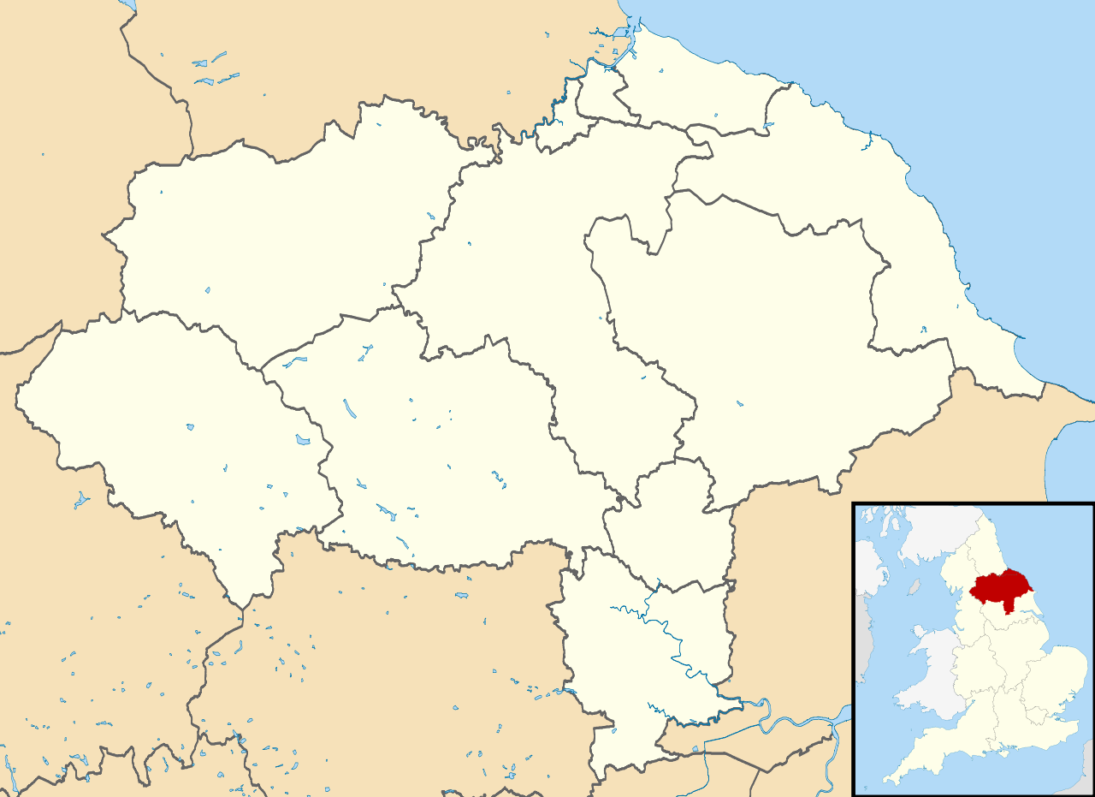
Single Point Of Contact (SPOC) - 01723 330730
Northallerton
5 The Applegarth DL7 8LZ
Scarborough
56-60 Castle Road YO11 1XE
Skipton
Mill Bridge House 4A Mill Bridge BD23 1NJ
Harrogate
7 North Park Road HG1 5PD
Selby
4 Rear Park Street
Selby YO8 4PW

Slide 6
Pregnancy Pathway Outline
To fast track any pregnant service user referred into NYH (Triage and comprehensive assessment, health and well being appointment and prescribing appointment within 3-5 days)
Improve communication between NYH and midwifery services (Regular written updates provided minimum of each trimester)
Priority given to partners of pregnant women referred into NYH
NYH follow Local Authority pre birth guidance relating to safeguarding of unborn babies. A referral will be made by NYH if criteria for childrens social care referral met.
Specific recovery plan and risk assessment will be devised to ensure safety of unborn baby and mother is paramount.
Increased frequency of clinical appointments and psychosocial appointments.
Increased drug testing (for those on substitute medication)
NYH will attend/ feed into pre birth multi agency meetings
Joint home visit with health visitor offered post birth

Slide 7
Clinical and psychological interventions Offered
Non Opiate Substance users- (Cannabis, cocaine, Ketamine etc)
A range of group work as well as tailored psychosocial interventions offered. Harm reduction and overdose awareness advice. Information provided around effects on unborn baby.
Health and wellbeing. Signposting.
Opiate Substance Users
Substitute prescribing therapies i.e methadone, buprenorphine. (Aim is to stabilise in treatment and eliminate illicit drug use. Adjustments generally made mid trimester i.e reduction plans and increase in dosage often required final trimester)
Naloxone. Overdose awareness and harm reduction advice. Regular clinical appointments and psychosocial support. Access to inpatient detox and rehab.
Alcohol Users
Harm Reduction, Alcohol detoxification, psychosocial and group work interventions. Access to inpatient detox.
Who we do not work with:
Under 18’s
Anybody misusing prescribed medication via GP
Those scoring under 14 on alcohol Audit (Although this would be open to discussion dependant upon need)

Slide 9
How do we support safeguarding?
Attendance at all MARAC/ MATAC meetings across county
Attend or feed into ICPC/RCPC/ CGM meetings
Specialist pregnancy pathway
Reporting of all referrals to CQC
Good links with partnership agencies ie IDAS/ NYP/ Probation
Home visit policy for individuals entering treatment with children under 5 years age
Attendance at SAR/ Domestic homicide reviews (where applicable)
Safeguarding policies in place
Lateral checks conducted for all individuals with children entering treatment
Referrals to MARAC/ CSC/ ASC where necessary
Safeguarding lead
DIS Reviews and learning
Regular audits

