Slide 1


NY Rise – Young People’s Drug and Alcohol Service

Slide 2
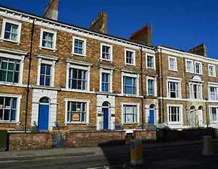
Service Criteria
We work with young people across North Yorkshire aged 10-19 and up to 24 with SEND who need specialist support around drug and alcohol use.

Slide 3
How to refer
Referral can be made by client, parent/carer, concerned other or professionals
We are a voluntary Service
We can discuss potential referrals prior to making a formal referral
To discuss how we can support please get in touch:
Telephone: 01723 330730
(option 2)
Freephone: 08000 141480
(option 2)
Email:NYYP.admin@Humankindcharity.org.uk
https://humankindcharity.org.uk/service/nyrise/

Slide 4
What we offer
Structured support to stop or reduce drug or alcohol use
• Support to improve health and well-being (including sexual health support and smoking cessation advice)
• Education and advice around drugs and alcohol
• Support family members of young people working with NY Rise and offer onward referrals when needed
• We can also provide guidance to schools, colleges and other professionals around referral processes and eligibility

Slide 5
Our Ambitions
To increase the availability and accessibility of drug and alcohol treatment in North Yorkshire.
To improve outcomes for the young people of North Yorkshire
To be a key partner agency for Children’s and Young People’s services in North Yorkshire

